Slide 1
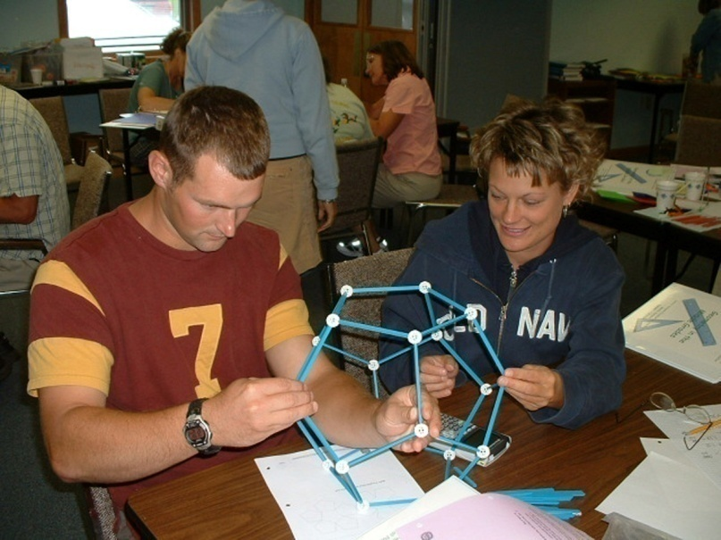
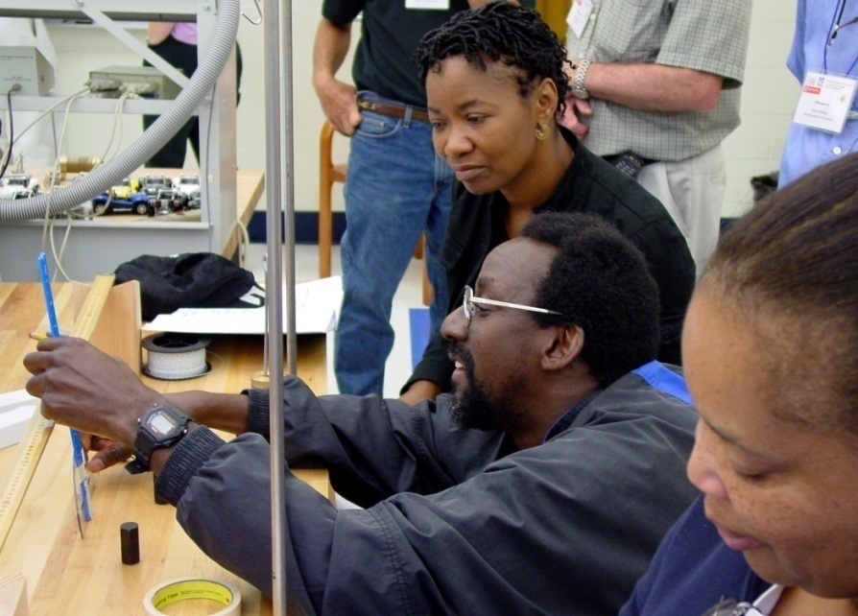
SFASU’s Texas Middle and Secondary Mathematics Project in the National Perspective
James Hamos
Division of Undergraduate Education
Directorate for Education and Human Resources
National Science Foundation

Slide 2
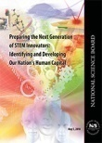
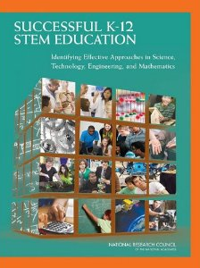
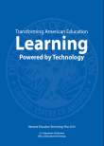
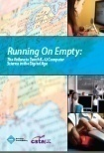
Relevant National Reports for STEM Education
Expanding Underrepresented Minority Participation: America's Science and Technology Talent at the Crossroads (2011)
Rising Above the Gathering Storm Revisited: Rapidly Approaching Category 5 (2010)
Preparing Teachers, Building Evidence for Sound Policy (2010)
Transforming American Education: Learning Powered by Technology (2010)
Running on Empty: Failure to Teach K-12 Computer Science in the Digital Age (2010)
Preparing the Next Generation of STEM Innovators (2010)
Prepare and Inspire: K-12 Education in STEM for America’s Future (2010)
Successful K-12 STEM Education: Identifying Effective Approaches in Science, Technology, Engineering, and Mathematics (2011)
New reports

Slide 3
The National Science Foundation Enabling the Nation’s future through discovery, learning and innovation
To promote the progress of science; to advance the national health, prosperity, and welfare; to secure the national defense; and for other purposes
Basic scientific research and research fundamental to the engineering process,
Programs to strengthen scientific and engineering research potential,
Science and engineering education programs at all levels and in all fields of science and engineering, and
An information base on science and engineering appropriate for development of national and international policy.
from National Science Foundation Act of 1950

Slide 4
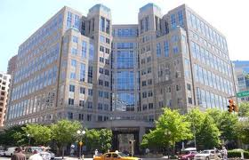
NSF: The Innovation Agency
For 60 years the National Science Foundation has played a central role in innovation by catalyzing the development of fundamental ideas in science and engineering and supporting the people who generate them. Today, NSF is positioned to strategically stimulate innovative research that connects the science and engineering enterprise with potential economic, societal, and educational benefit.

Slide 5
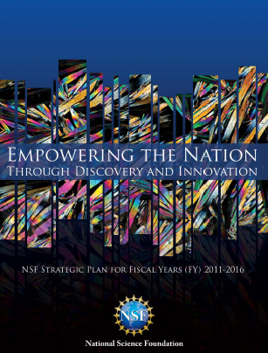
NSF Strategic goals: 2011-2016
Transform the Frontiers
Innovate for Society
Perform as a Model Organization
Source: NSF Strategic Plan: FY 2011-2016

Slide 6
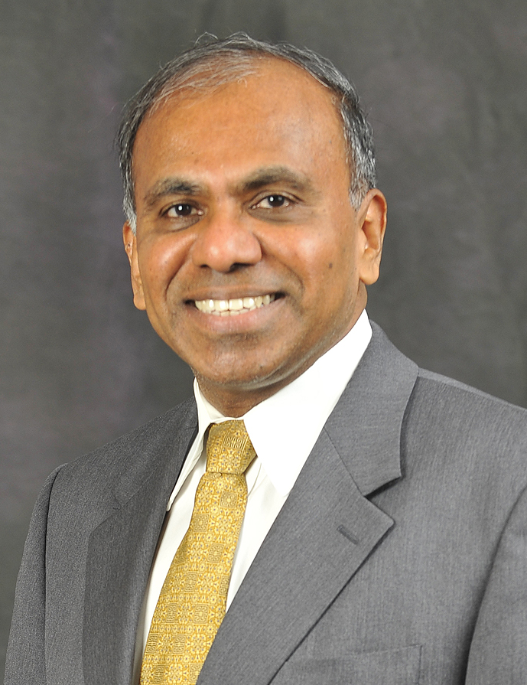
Education at all levels and settings has been, and will continue to be, a vital part of NSF's portfolio in cultivating "homegrown talent" in the globally competitive innovation marketplace. Bolstering education at all levels--from elementary school to community college and the post-graduate level--is the only way for the U.S. to maintain its edge in scientific and engineering innovation.
Dr. Subra Suresh Director, NSF
Remarks on the NSF's 2012 Budget Request to Congress – February 14, 2011

Slide 7
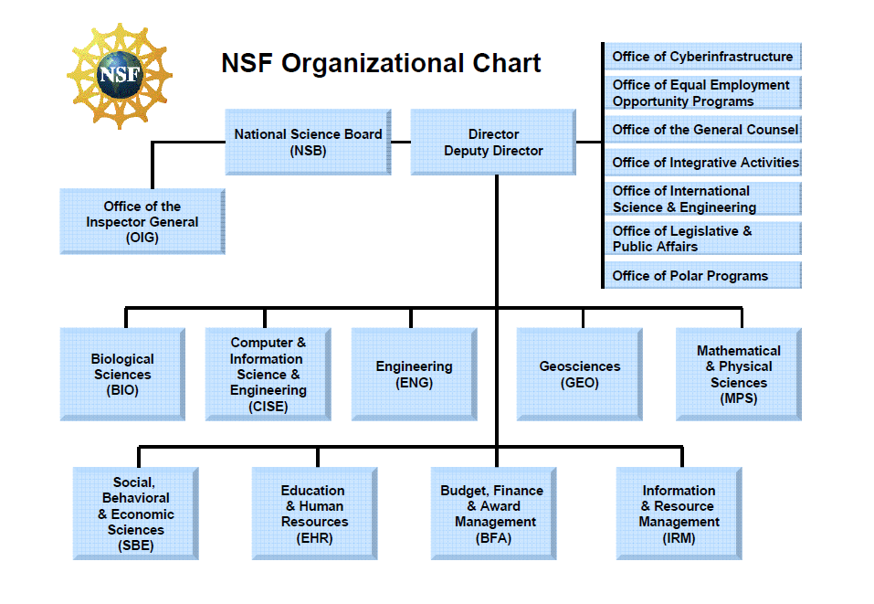

Slide 8
Goals of NSF’s Directorate for Education and Human Resources
Prepare the next generation of STEM professionals and attract and retain more Americans to STEM careers.
Develop a robust research community that can conduct rigorous research and evaluation that will support excellence in STEM education and that integrates research and education.
Increase the technological, scientific and quantitative literacy of all Americans so that they can exercise responsible citizenship and live productive lives in an increasingly technological society.
Broaden participation (individuals, geographic regions, types of institutions, STEM disciplines) and close achievement gaps in all STEM fields.

Slide 9
NSF’s Math and Science Partnership
A research & development effort at NSF for building capacity and integrating the work of higher education with that of K-12 to strengthen and reform mathematics and science education
Launched in FY 2002 as a result of legislative interest and was also a key facet of the No Child Left Behind vision for K-12 education
Strongly reauthorized as part of the America COMPETES Act of 2007 and provided with additional appropriation in the American Recovery and Reinvestment Act of 2009 and the FY 2009 federal budget

Slide 10
Program Overview
The MSP program seeks to improve K-12 student achievement through a sharp focus on three interrelated issues:
Ensuring that all students have access to, are prepared for and are encouraged to participate and succeed in challenging and advanced mathematics and science courses;
Enhancing the quality, quantity and diversity of the K-12 mathematics and science teacher workforce; and
Developing evidence-based outcomes that contribute to our understanding of how students effectively learn mathematics and science.
NSF's MSP program coordinates its effort with programs of the U.S. Department of Education in the expectation that effective innovations in mathematics and science education will be disseminated into wider practice.

Slide 11
Through the Math and Science Partnership program, NSF awards competitive, merit-based grants to teams composed of institutions of higher education, local K-12 school systems and supporting partners. At their core, Partnerships contain at least one institution of higher education and one K-12 school system.

Slide 12
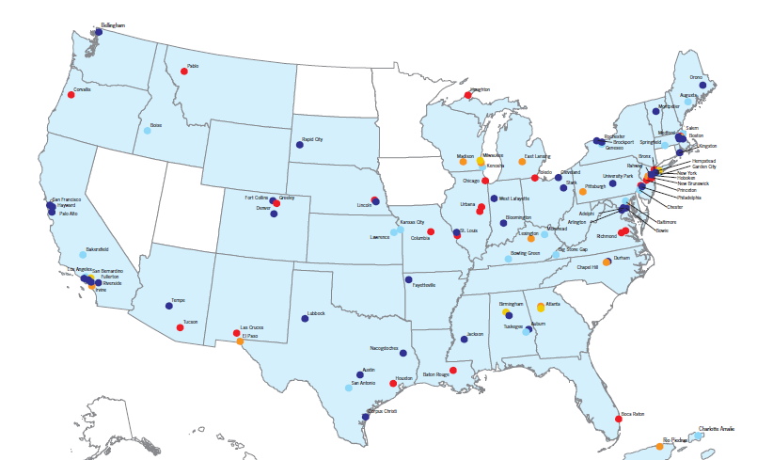
National Distribution of MSP Awards Since Program Inception
Texas Middle and Secondary Mathematics Project

Slide 13
MSP Key Features
Partnership-Driven
Teacher Quality, Quantity and Diversity
Challenging Courses and Curricula
Evidenced-Based Design and Outcomes
Institutional Change and Sustainability

Slide 14
Impacts on Students
Increased proficiency of students across the MSP portfolio on state mathematics assessments

Slide 15
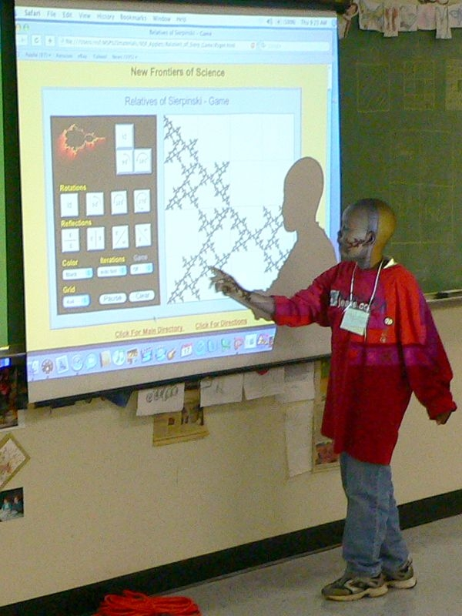
As an R&D effort, what are we learning?
How has the Texas Middle and Secondary Mathematics Project contributed?

Slide 16
Partnership-Driven

Slide 17
Scope of Partnership Projects
over 1,400 public school districts or consortia have been partners
19.0% in cities, 29.2 % in suburbs, 16.6 % in towns, and 35.2% in rural areas.
over 6,000 schools have worked with MSP projects in some capacity
44.9% are elementary schools, 28.2 % are middle schools, 27.4 % are high schools, and 1.0% are ungraded schools
over 240,000 teachers have participated in MSP-supported professional development
234 institutions of higher education have been partners, with more than 2400 faculty members and administrators participating

Slide 18
Findings from the Texas Middle and Secondary Mathematics Project
Since its onset, the TxMSMP has maintained a partnership with 12 East Texas independent school districts with extended efforts among additional districts
Each core partner district has at least one representative who has attended the professional development sessions for administrators
Improved the awareness and involvement of mathematics higher education faculty regarding preparation and professional development of teachers by:
involving mathematics faculty from other higher education institutions across the state in the project operation
noting evidence within other college/university mathematics departments of curricular and programmatic changes designed and implemented to better meet the needs of 4 - 12 mathematics teachers

Slide 19
Challenging Courses and Curriculum

Slide 20
What are we learning?
Through new long-term and coherent courses and programs, the involvement of STEM faculty and their departments in pre- and in-service education enhances content knowledge of teachers
In Western Washington University’s North Cascades and Olympic Science Partnership, which includes local community colleges and 28 predominately rural school districts, over 150 teachers have been engaged in a long-term experience of three 80-hour summer academies and at least 40 hours of professional development in each of the academic years. The sequence of learning experiences included immersions in science content with connections to instructional materials and classroom practice. Additional experiences focused on collaborative practices, facilitation strategies and leadership skills. This strategic, systematic approach to professional development has resulted in positive and measurable changes in teacher leaders’ knowledge and skills.

Slide 21
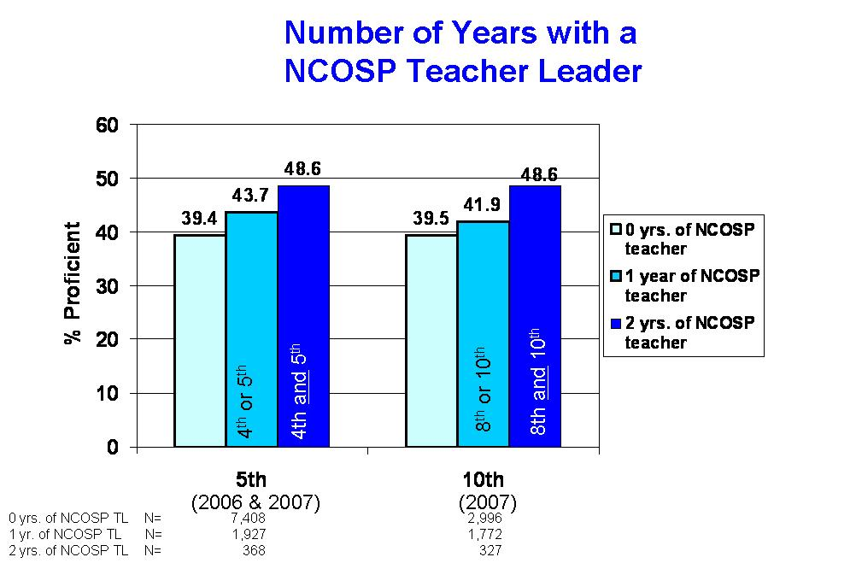
North Cascades and Olympic Science Partnership
Students who have NCOSP teacher leaders for one and two years of instruction are more likely to score proficient on state assessments than students who do not have such a teacher.

Slide 22
Findings from the Texas Middle and Secondary Mathematics Project
At the start of the TxMSMP, over 40% of middle school and 20% of high school mathematics teachers in Texas were not certified to teach secondary mathematics… the goal, then, was to
Improve the capacity of East Texas teachers in 4 – 12 grade-level mathematics classrooms through:
graduate degree programs consisting of a series of mathematics courses, leadership and mentoring courses, projects, portfolios, and exams, enabling teachers to become Texas Master Mathematics Teachers
mentoring by university mathematics faculty
teacher involvement in summer mathematics enrichment opportunities for middle and high school students in their respective school districts

Slide 23
Teacher Quality, Quantity and Diversity

Slide 24
What are we learning?
Teachers-in-residence on college campuses incorporate teacher expertise to broaden discussions of teaching and learning, and to support new efforts in teacher preparation
The Math & Science Partnership of Southwest Pennsylvania, led by the Allegheny Intermediate Unit, designed its Teacher Fellow experience to build intentional feedback loops between K-12 and IHEs, and also improve math and science learning experiences for undergraduates. K-12 Fellows and higher education mentors revise courses with the ultimate goal of improving undergraduate education and preparing pre-service students aspiring to become teachers. By the summer of 2007, 43 K-12 teachers, representing nearly 30 school districts, had participated in the Teacher Fellow program and 74 college courses had been revised through this process. This has resulted in greater success for IHE students: in at least 75% of revised courses, more than 80% of the students are attaining proficiency (a grade of C or above).

Slide 25
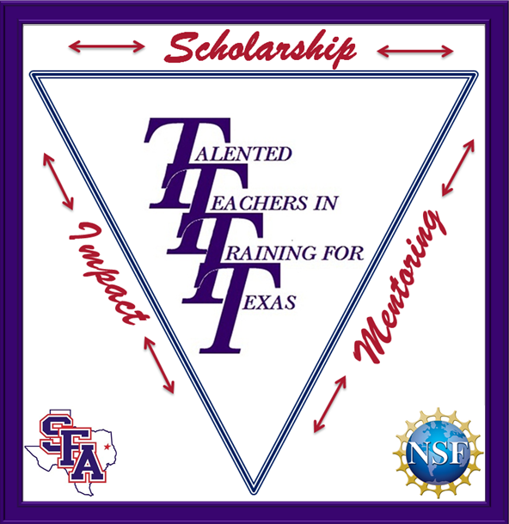
Findings from the Texas Middle and Secondary Mathematics Project
With funding through NSF’s Robert Noyce Teacher Scholarship Program, SFASU, together with Angelina College and the Region 7 Education Service Center, has created Talented Teachers in Training for Texas (T4), which provides opportunities for interested undergraduate students to learn more about STEM teaching careers.

Slide 26
Evidence-based Design and Outcomes

Slide 27
What are we learning?
Research methods in ethnography and social network analysis help document change in institutions and partnerships
The Milwaukee Mathematics Partnership, led by the University of Wisconsin – Milwaukee, has a major objective to distribute leadership across Milwaukee’s schools based on the premise that schools (1) with stronger collaborative networks and (2) where key personnel such as the school-based math teacher leader and district-based math teaching specialist play important roles in that network will demonstrate stronger student achievement results in mathematics. The project has employed Social Network Analysis – the study of relationships within the context of social situations – as a method for assessing distributed leadership, and found that schools embracing the concept of distributed leadership demonstrated stronger school-level achievement outcomes.

Slide 28
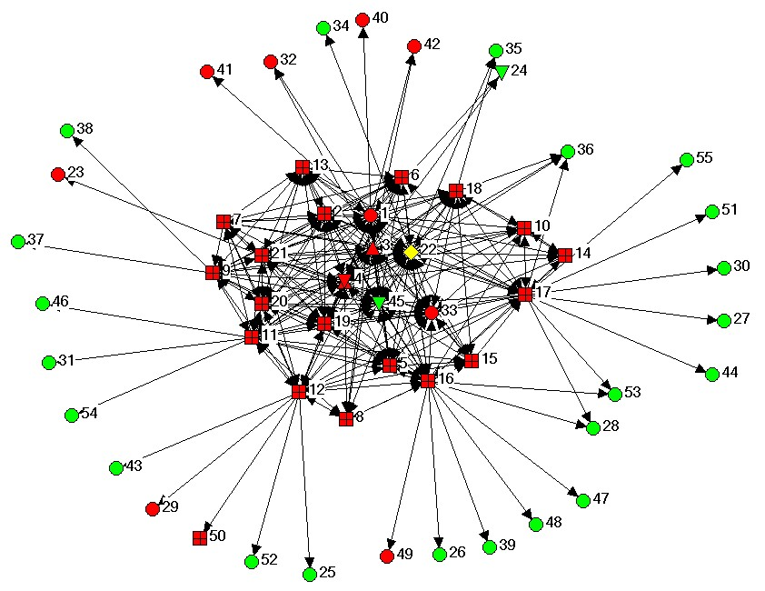
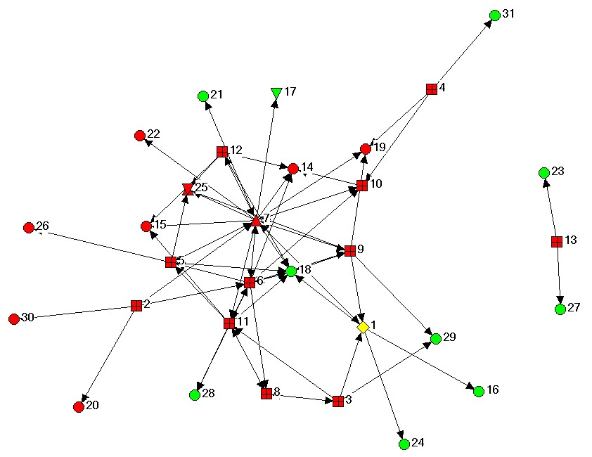
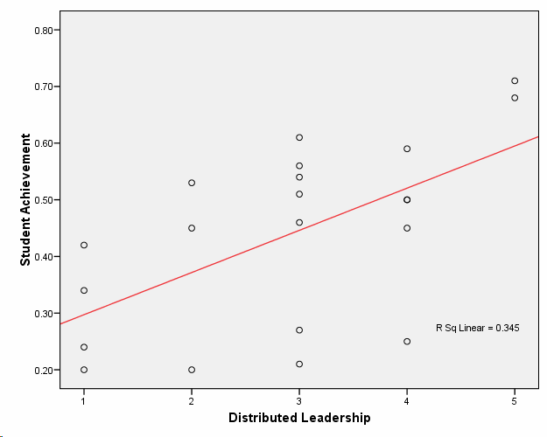
Milwaukee Mathematics Partnership
School with High Distributed Leadership
School with Emerging Distributed Leadership
Distance is important. Closer nodes are more tightly connected than nodes that are further apart.
Color is important. Individuals from the subject school are colored red and those who are not at the school are green. The MTL for each school is colored yellow.
Shape denotes role as follows: Diamond = MTL; Overlapping Triangles = Principal; Up Triangle = Literacy Coach; Down Triangle = MTS; Square = Teacher; Circle = Other role

Slide 29
Findings from the Texas Middle and Secondary Mathematics Project
The MSP Knowledge Management and Dissemination Project, led by Horizon Research, Inc., conducted a series of case studies of MSP projects as a framework for understanding the partnerships between school districts and institutions of
higher education. The goal was to describe how MSP partnerships were designed to foster sustained improvement in mathematics and/or science education, the nature of the challenges that these partnerships faced, and how those challenges were addressed, to help inform future efforts at system improvement.
One of only four case reports: Sustaining Improvement Efforts to Deepen Secondary Teachers’ Mathematics Content Knowledge: The Case of the Texas Middle and Secondary Mathematics Project, Stephen F. Austin State University’s MSP Math and Science Partnership

Slide 30
Institutional Change and Sustainability

Slide 31
What are we learning?
Revised tenure & promotion policies recognize faculty for scholarly contributions to the advancement of math and science education
A hallmark of the MSP program is its requirement that science, engineering and mathematics faculty from higher education partner organizations commit to working on issues of K-12 mathematics and science education. Some MSP projects have developed strategies to reduce barriers and motivate faculty to increase their time and effort on activities potentially critical to increasing K-12 student achievement. The Partnership for Reform in Science and Mathematics’ Strategy 10 – involving all levels of the University System of Georgia, from individual faculty members to departments to Schools and Colleges to the Board of Regents – resulted in a new advocacy policy that encourages and values joint higher education / K-12 work. Faculty in Georgia can now be promoted based on Scholarship in Discovery, in Teaching & Learning and/or in Engagement.

Slide 32
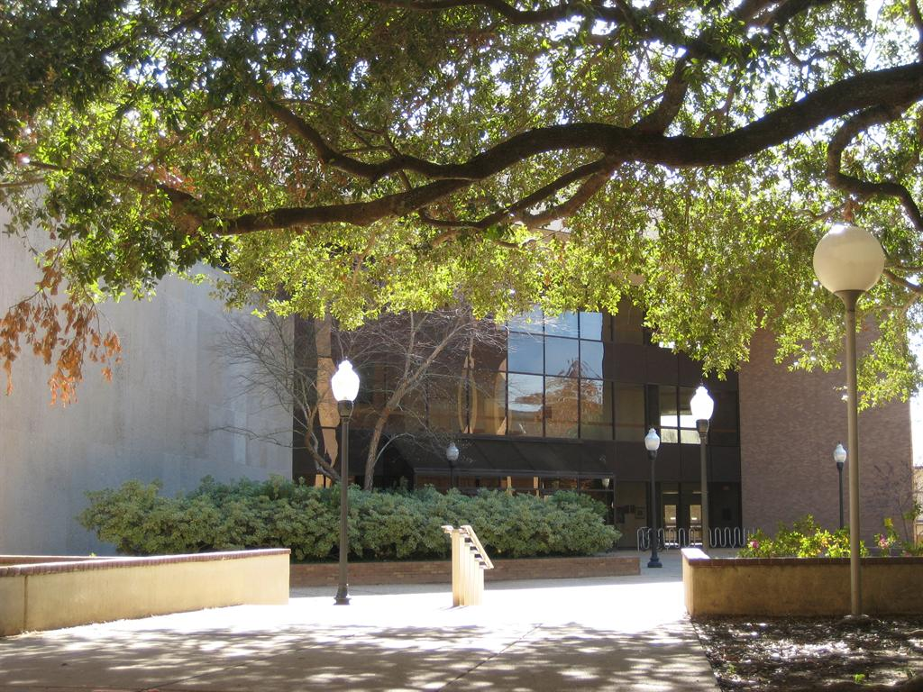
Findings from the Texas Middle and Secondary Mathematics Project
Creation of the STEM Research & Learning Center, with expectations to:
increase STEM awareness and public perception,
facilitate innovation in STEM university education,
provide support for student mentoring during transitional periods in their education,
guide STEM teacher induction during the first three years in the classroom, and
empower STEM teacher-leaders to transform their districts from within

