Slide 2
Announcing…
The Stephen F. Austin State University
STEM Research and Learning Center
… A Response to the National Call for Reform

Slide 3
Science, Technology, Engineering, and Mathematics … from a National Perspective
Today, more than ever before, science and mathematics hold the key to our survival as a planet and our security and prosperity as a nation.
The greatest long-term threat to U.S. national security is not terrorists wielding a nuclear or biological weapon, but the erosion of America’s place as a world leader in science and technology.
We must launch a national campaign to make math and science a national priority. And we must do so quickly … before it’s too late!
(Rising Above the Gathering Storm Revisited, 2010)

Slide 4
What we need, nationally:
An estimated 12.9 million workers reported needing at least a bachelor’s degree level of Science and Engineering knowledge with 9.2 million reporting a need for knowledge of the natural sciences.
(National Science Board, 2006)
While only 4% of the nation’s workforce is composed of scientists and engineers, this group disproportionately creates jobs for the other 96%.
(National Science Board, 2010)
“Gentlemen, we have run out of money.
It is time to start thinking.”
Sir Ernest Rutherford, Nobel Laureate (Physics)

Slide 5
According to Bill Gates, Founder of the Microsoft Corporation… “Where is Sputnik when we need it?”
Results of Sputnik, 1957:
Precedent-shattering Federal assistance to education was provided via agencies such as the Department of Defense and the National Science Foundation.
New curricula in mathematics and science were researched, field-tested, and implemented.
A national movement to improve the teaching and learning of these core disciplines emerged.
The number of qualified graduates in STEM fields surged.

Slide 6
The Plan at Stephen F. Austin State University… SFA STEM Research and Learning Center
The primary goal of the Stephen F. Austin State University STEM Research and Learning Center is to increase the number of students who are interested in science, technology, engineering, and mathematics, and who are academically prepared to enter STEM careers.

Slide 7
U.S. students are not obtaining the STEM knowledge they need to succeed.
About 30% of first year college students must take remedial science and math classes because they are not prepared to take college-level courses.
The U.S. now ranks 25th among 30 industrialized countries in mathematics.
Of the 70 finalists in a National Security Agency (NSA) supported computer coding contest, 20 were from China, 10 from Russia and 2 from the U.S.
(Rising Above the Gathering Storm, National Academies, 2005)

Slide 8
The STEM Initiative …capturing the attention of our students in sciences and mathematics …
Today, only 23% of college freshmen declare a STEM major … but just 40% of those receive a STEM degree within 6 years (about 6% of the total 3.6 million student population). We cannot make progress if these students are leaving STEM fields. (Arne Duncan, 2009)
Only 3 of the current top 10 college majors are categorized as science, technology, engineering or mathematics: Nursing – 3rd, Biology – 4th, and information technology – 10th.
(Princeton Review, 2010)
Today, for the first time in history, America’s younger generation is less well-educated than its parents.
(National Center for Education Statistics, 2005)

Slide 9
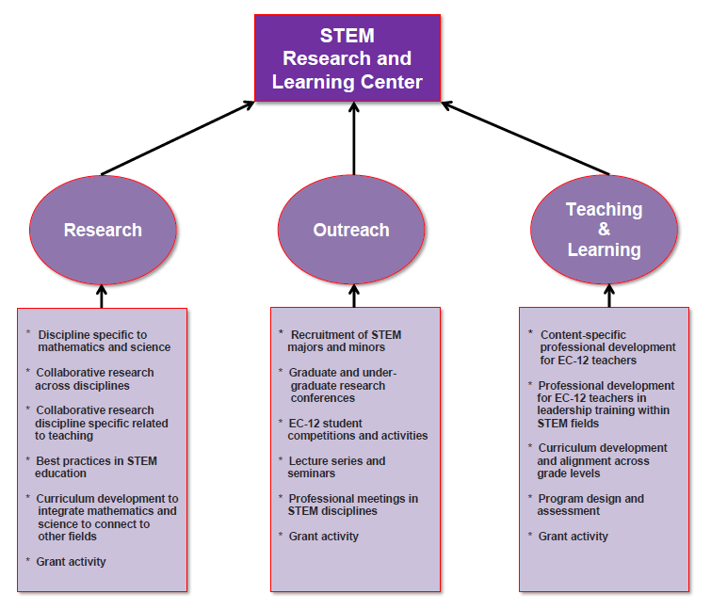

Slide 10
SFA STEM Research and Learning Center Dr. Kimberly Childs, Executive Director
Faculty Co-Directors:
Dr. Lesa Beverly, Mathematics
Dr. John Moore, Chemistry
Dr. Josephine Taylor, Biology
Center Coordinator: Ms. Linda Boozer
Grants Project Coordinator: Dr. Jana Redfield
Research Associate, Mathematics: Ms. Betsy Childs
Research Associate, Science: TBA

Slide 11
Current Grant Funded Projects
Math, Science, Technology Teacher Preparation Academy – Texas Higher Education Coordinating Board
Texas Middle and Secondary Mathematics Project: Leadership Initiative, Math/Science Partnership - National Science Foundation
Texas Leadership Initiative: Mathematics Instruction Transformed (LIMIT) – National Science Foundation
Talented Teachers in Training for Texas (T4) – National Science Foundation

Slide 12
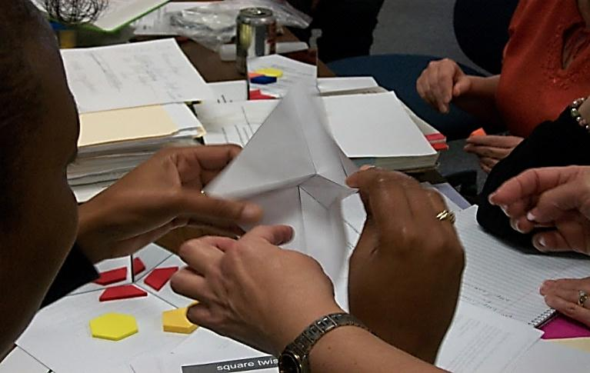
STEM Activities on Campus
Student Focused Instruction
Quality Teacher Preparation
Interactive Learning

Slide 13
Research Sponsored Activities in Progress:
“The SFA Mathematics, Science, and Technology Teacher Preparation Academy: A Model that Works," in progress. Authors: Dr. Jana Redfield, Dr. Lesa Beverly, Dr. Jo Taylor, Dr. John Moore, and Dr. Kimberly Childs.
“Connecting the Dots,” in progress. Authors: Dr. Keith Hubbard, Dr. Kimberly Childs, and Ms. Betsy Childs.
"Interpreting Mathematics Teachers’ Needs for Professional Development,” in progress. Authors: Dr. Keith Hubbard and Ms. Meagan Hensley.
“Teaching Factoring: Fun, Facts, and Faux Pas,” submitted. Authors: Dr. Keith Hubbard, Dr. Lesa Beverly and Ms. Meagan Hensley.
Expected Submission: Fall, 2011

Slide 14
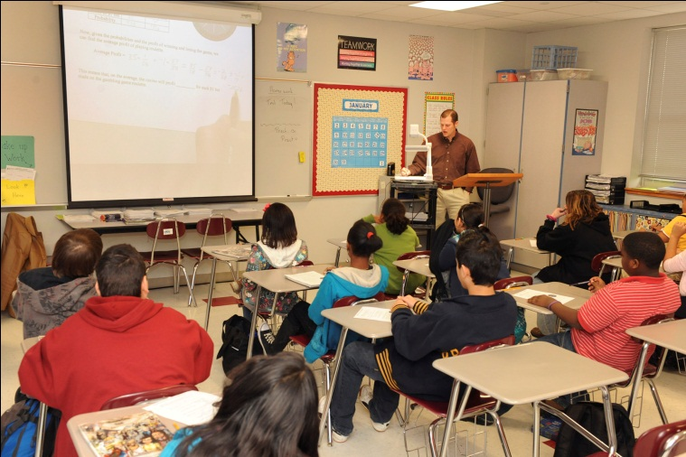
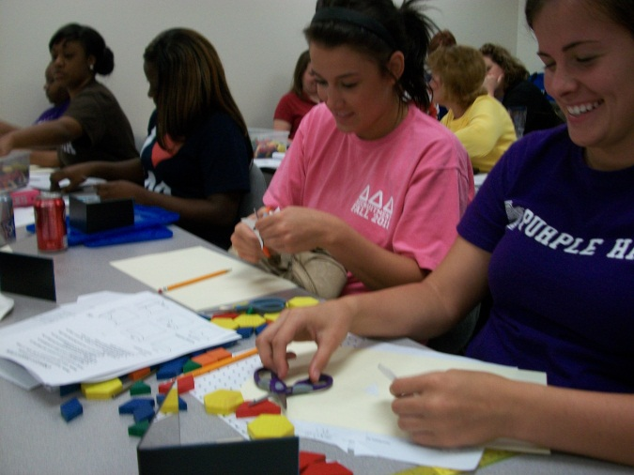
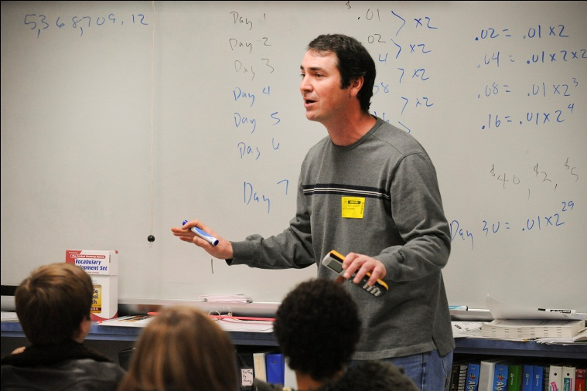
“The Texas Middle and Secondary Mathematics Project: A Model that Works.” Authors: Dr. Kimberly Childs, Dr. Debbie Pace, Ms. Betsy Childs.
"Spatial Hydrogeochemical Characterization of the Colorado River: Delineation of Subaqueous Karst Springs at Colorado Bend State Park, Texas." Author: Dr. Kevin Stafford.
Expected Submission: Fall, 2011

Slide 15
"Measuring Student Success and Teacher Retention as Measures of Effectiveness of Grant funded programs,” in progress. Authors: Dr. Keith Hubbard and Ms. Meagan Hensley.
"A Study of Algebra/Geometry Connections in a Multicultural Classroom,” in progress. Authors: Dr. Kimberly Childs and Ms. Betsy Childs.
“Preliminary Extraction of Amaranth DNA,” in progress. Author: Dr. Donald Pratt.
"Production Of Enzyme Inhibitors In Milk By Lactobacillus Fermentation For Use As Prolyl Peptidase Inhibitors,” in progress. Author: Dr. Bea Clack and Mr. Jeff Hargrove.
Expected submission: Spring, 2012.

Slide 16
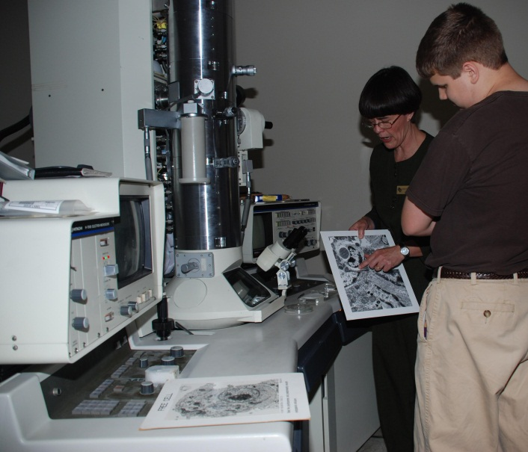
"Effects of Male Color, Parasite Load, and Territory Quality on Mating Success and Fitness in Painted Buntings, Passerina ciris." Authors: Dr. Brent Burt and Dr. Matthew Kwiatkowski. Longitudinal Study in progress.
Expected submission: Summer, 2012.

Slide 17
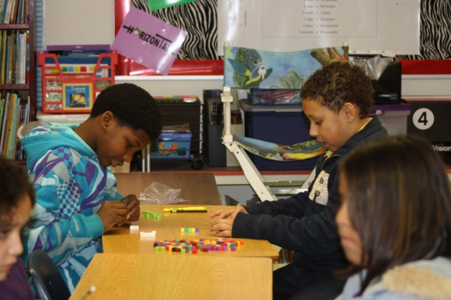
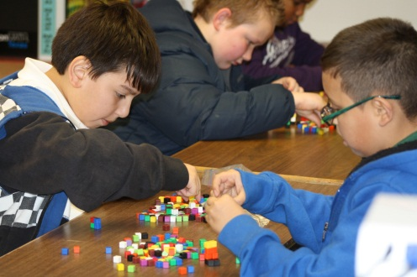
Student-Centered Activities…
Girl Scout and Boy Scout STEM Days
Math/Science Day Competitions for K – 12 Students
SMASH (Summer Math and Science Highlights) Camp for entering SFA freshmen
Math/Science/Technology Summer Camps for K – 12 Students
STEM Mania Days for middle, secondary, and college-level students

Slide 18
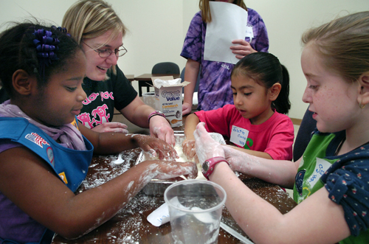
SFA’s STEM Research and Learning Center hosted the first annual
“Girl Scout STEM Day at SFA!”
Young Girl Scouts are up to their elbows in a lesson on polymers using corn starch and water. These girls and approximately 90 other Scouts from around the area participated in different sessions discussing polymers, metamorphosis, topology, probability, arithmetic, and measurement.

Slide 19
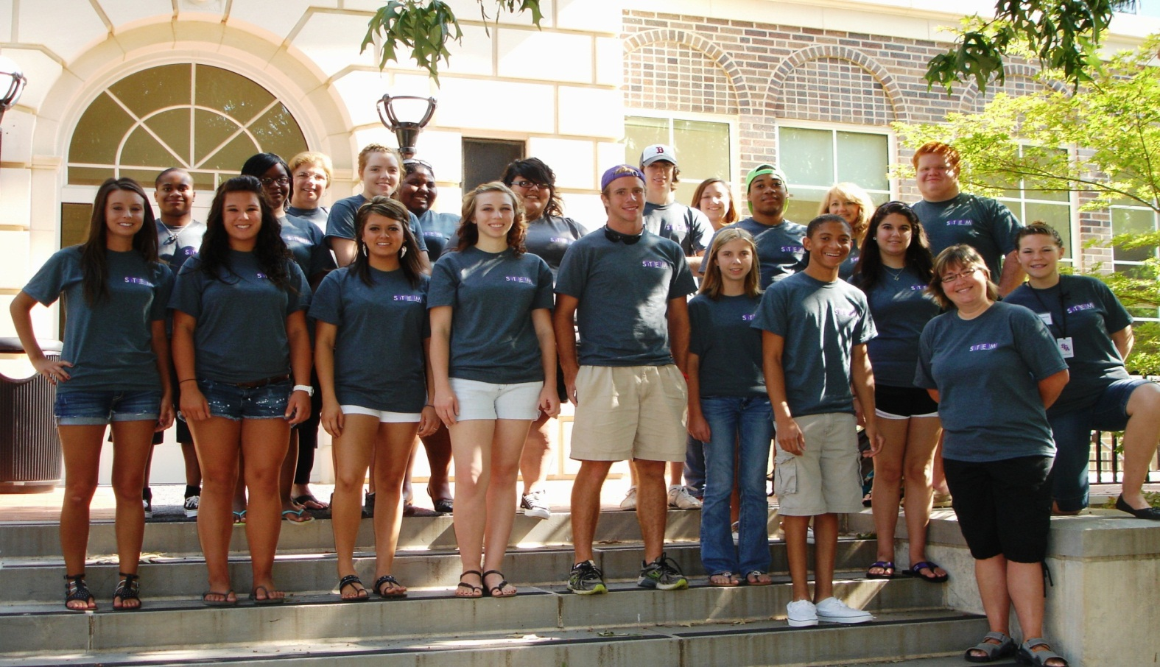
SMASH Camp 2011
Incoming SFA Freshman

Slide 20
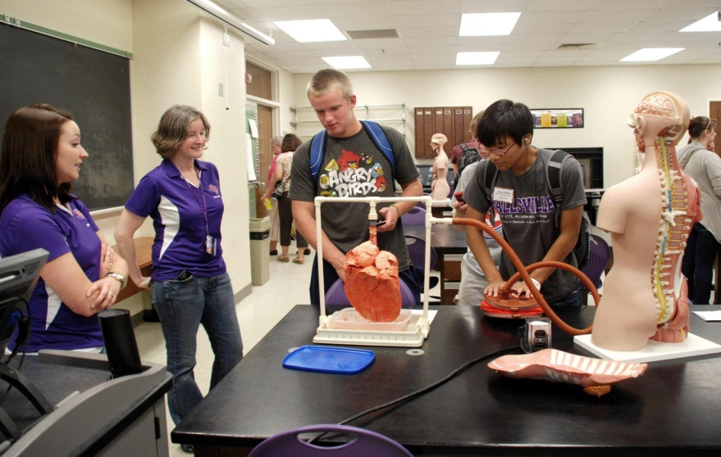
Community-Centered Activities …
Lecture Series and Seminars
STEM Awareness Days

Slide 21
The STEM Initiative … Catch the Vision!
The future of our nation and people depends not on just how well we educate our children generally, but on how well we educate them in mathematics and science, specifically.”
Senator John Glenn, Ohio

Slide 22
Acknowledgements:
The SFA Board of Regents
Dr. Baker Pattillo
SFA President
Dr. Richard Berry
SFA Provost and VPAA
Dr. Carrie Brown
SFA Director of Research and Sponsored Programs
Dr. James Hamos
National Science Foundation, Washington, D.C.
Friends of the SFA STEM Research and Learning Center.

Slide 23
College of Sciences and Mathematics
Dean’s Advisory Board
College of Sciences and Mathematics
Chairs and Directors
College of Sciences and Mathematics
Faculty and Staff

Slide 24
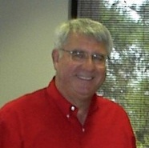
Dr. Jasper E. Adams
… whose visionary leadership led us to the place where we find ourselves today. May he always
be remembered as a servant leader whose life impacted so many. The mission he set forth to accomplish is carried forward through the
SFA STEM Research and Learning Center.

