Slide 1
What is STEM Education?
Kimberly M. Childs, Dean
College of Sciences and Mathematics
Stephen F. Austin State University

Slide 2
Science, Technology, Engineering, and Mathematics
From a national perspective…
Today, more than ever before, science and mathematics hold the key to our survival as a planet and our security and prosperity as a nation.
We need better aligned math and science classes and more math and science teachers. We must launch a national campaign to make math and science a national priority. As we must do so quickly … before it’s too late!

Slide 3
What we need …
Although much has been done to promote STEM education, we have yet to capture the attention of our students in mathematics and science.
(Before it's too late: a report to the nation, 2000)
America must continue to innovate. We don’t have a single brain to waste. Math and science are the engines of innovation. With these engines we can lead the world. We must demystify math and science so that all students feel the joy that follows understanding.
(Michael Brown, University of Texas Southwestern Medical School)

Slide 4
Reminding the Stakeholders – What is STEM Education?
Teaching and learning strategies that challenge students to innovate and invent
Modeling real world contexts for learning and work
Integrating math, science, and technology with other subject areas
Creating a design process that drives student engagement
How do we help students make sense of the world and solve new and novel problems?

Slide 5
Two National Challenges to Address:
STEM education is not coordinated horizontally among states or aligned vertically through grade levels.
The Nation faces a chronic shortage of qualified teachers who are adequately prepared and supported to teach STEM disciplines effectively.

Slide 6
U.S. students are not obtaining the STEM knowledge they need to succeed.
“The danger exists that Americans may not know enough about science, technology, or mathematics to contribute significantly to, or fully benefit from, the knowledge-based economy that is already taking shape around us.”
About 30% of first year college students must take remedial science and math classes because they are not prepared to take college-level courses.
Rising Above the Gathering Storm
National Academies, 2007

Slide 7
What we know, globally:
The global competition in higher education is increasing. Although the U.S. has historically been a world leader in providing broad access to higher education, many other countries are expanding their own higher education systems, providing comparable educational access to their own population.
For instance, the number of new engineers produced in 2005
were:
U.S. – 70,000
India – 350,000
China – 600,000 (400,000 with B.S.)
(Subcommittee on Research of the Committee on Science U.S. House of Representatives, March 2006)

Slide 8
What we need, nationally:
An estimated 12.9 million workers reported needing at least a bachelor’s degree level of Science and Engineering knowledge with 9.2 million reporting a need for knowledge of the natural sciences.
(NSB Science and Engineering Indicators 2006 – S&E Labor Force)
“Today, only 23% of college freshmen declare a STEM major … but just 40% of those that elect STEM majors in the freshman year receive a STEM degree within 6 years (about 6% of the total 3.6 million student population). We cannot make progress if these students are leaving the STEM fields.” (Arne Duncan, 2009)

Slide 9
What we have, in Texas:
Texas has lower percentages of students taking Advanced Placement exams in Calculus, Biology, Chemistry, and Physics than the nation and lower percentages of students scoring a 3 or higher.
The number of Hispanic and African American students in Texas who score a 3 or higher on the Chemistry and Physics AP exams is fewer than 500.
Two of the most common reasons campuses were Academically Unacceptable under the state accountability system were failure to meet the TAKS math standards and failure to meet the TAKS science standards.
Math performance was one of the top reasons that campuses failed to meet federal AYP standards.

Slide 10
Why the STEM Initiative?
Although the United States has the most innovative and technologically efficient economy in the world, the STEM education system is failing to ensure that students have the knowledge and skills necessary to succeed in the 21st century workforce .
(National Science Board, 2007).
Fifteen-year-olds in the United Stated ranked 25th among peers from 34 countries on the Program for International Student Assessment, while China’s Shanghai finished at the top.
(Bloomberg, 2010)
Only 3 of the current top 10 college majors are categorized as science, technology, engineering or mathematics: Nursing – 3rd, Biology – 4th, and information technology – 10th.
(Princeton Review, 2010)

Slide 11
Where does this put us? We have a precedent to embrace change … Sputnik!
Precedent-shattering Federal assistance to education was provided via agencies such as the Department of Defense (National Defense Education Act) and the National Science Foundation.
New curricula in mathematics and science were researched, field-tested, and implemented.
A national movement to improve the teaching and learning of these core disciplines emerged.
The number of qualified graduates in STEM fields surged.

Slide 12
Recommendations from the National Science Board:
The National Science Foundation must exercise a significant leadership role in three areas:
Research on learning and educational practice and the development of instructional materials;
Development of human capital in STEM fields, including STEM teachers; and
Improvement of public appreciation for and understanding of STEM.

Slide 13
In Summary:
To have a well-trained workforce, we must educate
undergraduates in STEM fields, preparing them
as K – 12 math/science teachers,
for graduate education that leads to a professional career as an academic or research scientist, or
for the increasing number of jobs that require scientific and technological expertise.
(Subcommittee on Research of the Committee on Science U.S. House of Representatives, March 2006)

Slide 14
Announcing … The STEM Research and Learning Center
The primary goal of the Stephen F. Austin State University STEM Research and Learning Center is to increase the number of students who are interested in science, technology, engineering, and mathematics, and who are academically prepared to enter STEM careers.

Slide 15
Site of the SFA STEM Research and Learning Center
Classrooms, auditorium, and administrative offices are located
on the first floor of the Math Building.

Slide 16
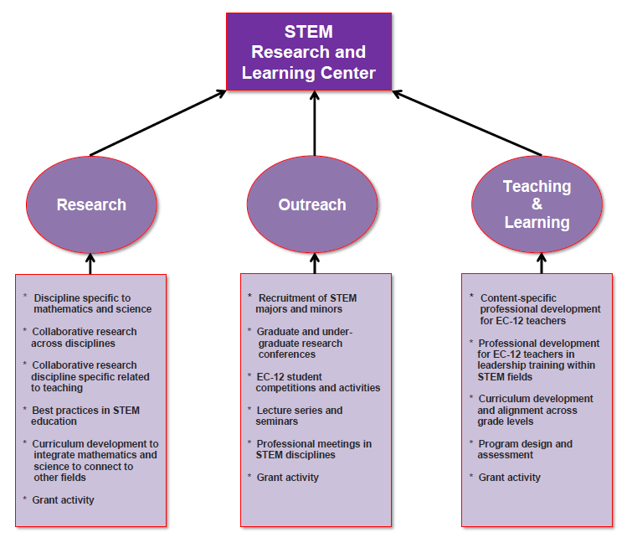

Slide 17
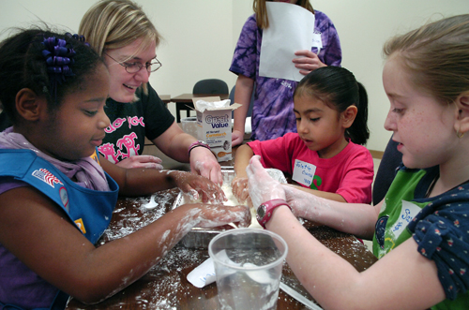
Young Girl Scouts are up to their elbows in a lesson on polymers using corn starch and water. These girls and approximately 90 other Scouts from around the area participated in different sessions discussing polymers, metamorphosis, topology, probability, arithmetic, and measurement.
SFA’s STEM Research and Learning Center hosted the first annual
“STEM Day at SFA!”

Slide 18
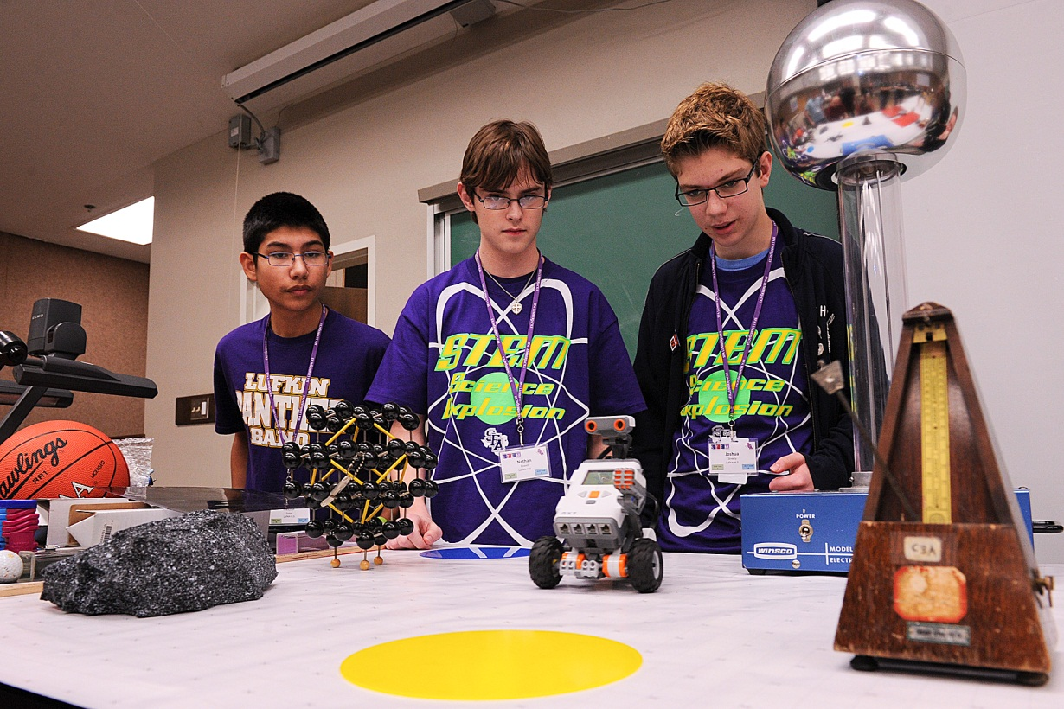
STEM Day: Science Explosion
East Texas high school students engage in activities and competitions with the goal to inspire them to pursue STEM careers. Students interact with SFA STEM faculty members, graduate and undergraduate students, and professionals representing a variety of STEM-related fields.

Slide 19
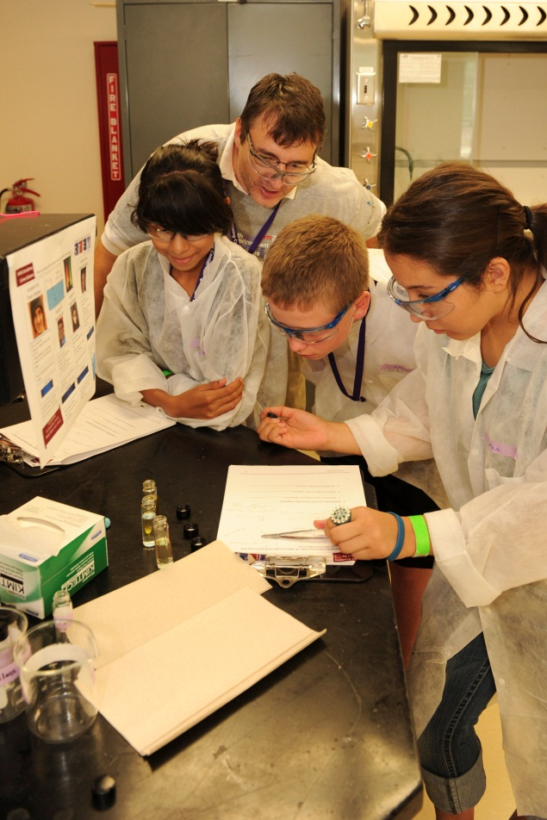
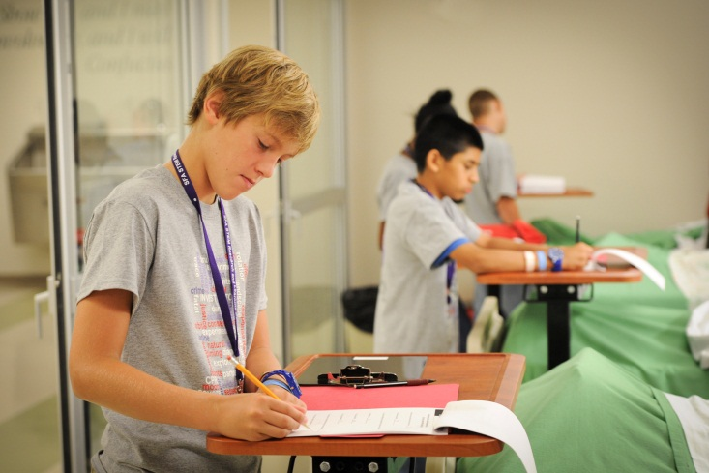
iMAS Academy
(Investigations in Mathematics and Science)
Middle-level students from area East Texas school districts attend a one-week camp where they have an opportunity to learn critical thinking and problem solving in science and math while “investigating” STEM careers in forensic science, engineering, nursing, astrology, and biology.

Slide 20
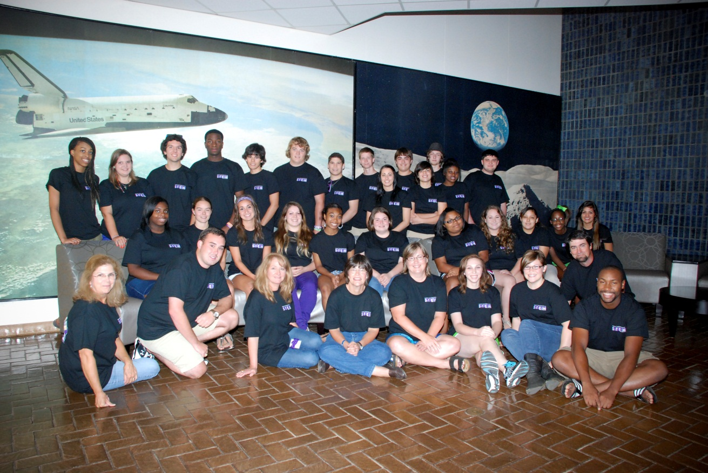
SMASH Camp
Summer Math and Science Highlights
Incoming SFA Freshmen majoring in a science discipline interact with SFA STEM faculty and district master teachers in activities to bridge the gap between high school and college-level content. A “live-on-campus” experience allowing students to build a support structure of faculty and fellow students.

Slide 21
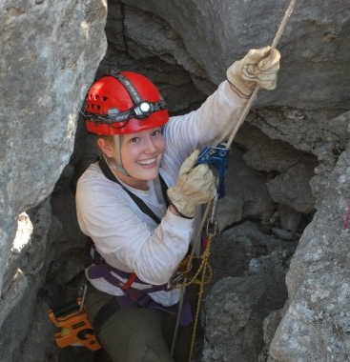
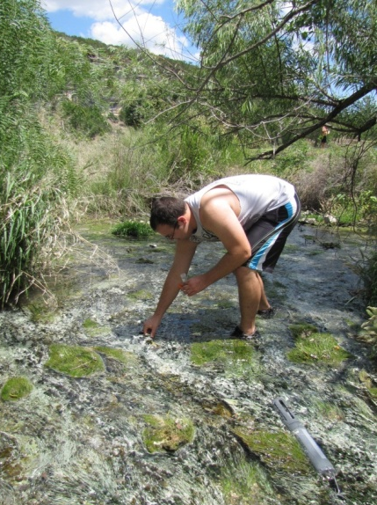
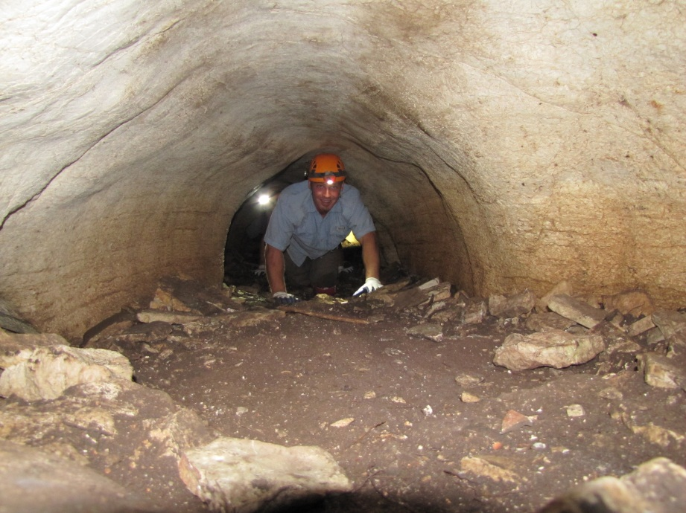
SFA Cave Camp
A week-long workshop for freshmen entering SFA designed to provide students with hands-on field experience in natural science. Each day of camp is filled with physical activity including hiking, cave exploration, kayaking and data collection at Colorado Bend State Park, Texas.

Slide 22
We Believe…
What I do today is important because I am paying a day of my life for it.
What I accomplish must be worthwhile because the price is high.
-- Anonymous

