Slide 1
Welcome Back!
Fall 2013

Slide 2
Introductions by Departments
Biology – Dr. John Moore
Chemistry and Biochemistry – Dr. Mike Janusa
Computer Science – Dr. Mike Pickard
Geology – Dr. Ken Farrish
Mathematics and Statistics – Dr. Debbie Pace
Nursing – Dr. Sara Bishop
Physics and Astronomy – Dr. Harry Downing

Slide 3
Introductions and Updates
Dean’s Office
Discovery & Research Center
  Introductions
  Core Repository operational Fall 2013
STEM Center
  Reorganization/Introductions
  Proposed high school STEM Academy
Academic Advising & Student Services Center

Slide 4
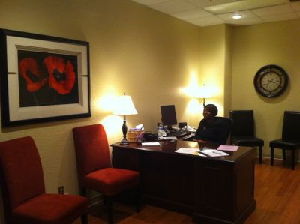
Academic Advising and Student Services Center
Introductions
Advising – Primarily after Mid-Semester
Degree Plans – Prior to Mid-Semester
Major Changes
Graduation Plans
Late Adds and Reinstatement
Resource Room
    Room 127

Slide 5
Academic Advising Center
Activities
STEM Major’s Fair
Summer Orientation
Showcase Saturday
Convocation
  September 5th @ 4:00pm

Slide 6
College of Sciences and Mathematics

Slide 7
College of Sciences and Mathematics

Slide 8
College of Sciences and Mathematics

Slide 9
College of Sciences and Mathematics

Slide 10
Updates
Assessment – Dr. Debbie Pace
Pre-Health Professions Program – Dr. Kevin Langford
Pre-Engineering Program – Dr. Dan Bruton
Engineering Program – Final Proposal submitted
  Tuition Revenue Bond – STEM Building
THECB

Slide 11
Policy Reminders and Updates
Graduation: Policy 6.8 Commencement
Commencement is an important symbol of the university's core function. Full-time faculty members are obligated to attend at least one commencement each academic year. For faculty teaching in the second summer term, attendance at the August ceremony is required.
CoSM attendance: December 2012 – 21%
May 2013 – 33%

Slide 12
Repeat grades policy: No longer “3-peat” – replaced with “most recent grade”
  Effective fall 2013
  Applied to prior and current students only if results in increased or unchanged GPA
Faculty Workload – College of Sciences and Mathematics (proposal)
  Tenure/Tenure-track may apply to their chair for workload reassignment (25%) applied specifically to research/scholarly activity
  Awarded in a two year “moving window” dependent on appropriate evaluations by the chair

Slide 13
The College at Work …
The Year that Was…

Slide 14
Congratulations!
Promotion to Professor
Dr. Alexandra VanKley – Biology
Tenure and Promotion to
Associate Professor
Dr. Joe Musser – Physics & Astronomy

Slide 15
Congratulations!
University Regents’ Professor
Dr. Harry Downing
College Teaching Excellence Award 2013
Dr. Josephine Taylor
Teaching Excellence Award for Service
Della Connor and Janice Hensarling
President’s Award
Ms. Angie Brazil

Slide 16
Thank you!
Retiring – August 31, 2013
Linda Boozer – 30 years of service to SFA
Bob Feistel – 24 years of service to SFA
Diane Proctor - 9 years of service to SFA

Slide 17
Completed Faculty Research Grants funded by
SFA Office of Research & Grant Sponsored Programs
Dr. Sarah Canterberry
Dr. Kevin Stafford
Dr. Alyx Frantzen
Dr. Jane Long

Slide 18

Completed Faculty Research Engagement Grants funded by
STEM Research and Learning Center
Dr. Brent Burt
Dr. Beatrice Clack
Dr. Anthony Duben
Dr. Jennifer Gumm
Dr. Nick Long
Dr. Kent Riggs

Slide 19
New NSF Funding – Internet Bandwidth
The CC-NIE Networking Infrastructure project overcomes geographical and technological barriers at Stephen F. Austin State University (SFA) with major upgrades to network infrastructure, connectivity, and the science DMZ. These upgrades support expanded research and teaching capabilities and improve capacity for data-driven research across a variety of STEM disciplines.
Dr. Dan Bruton, Co-PI
$450,000 pending from the National Science Foundation

Slide 20
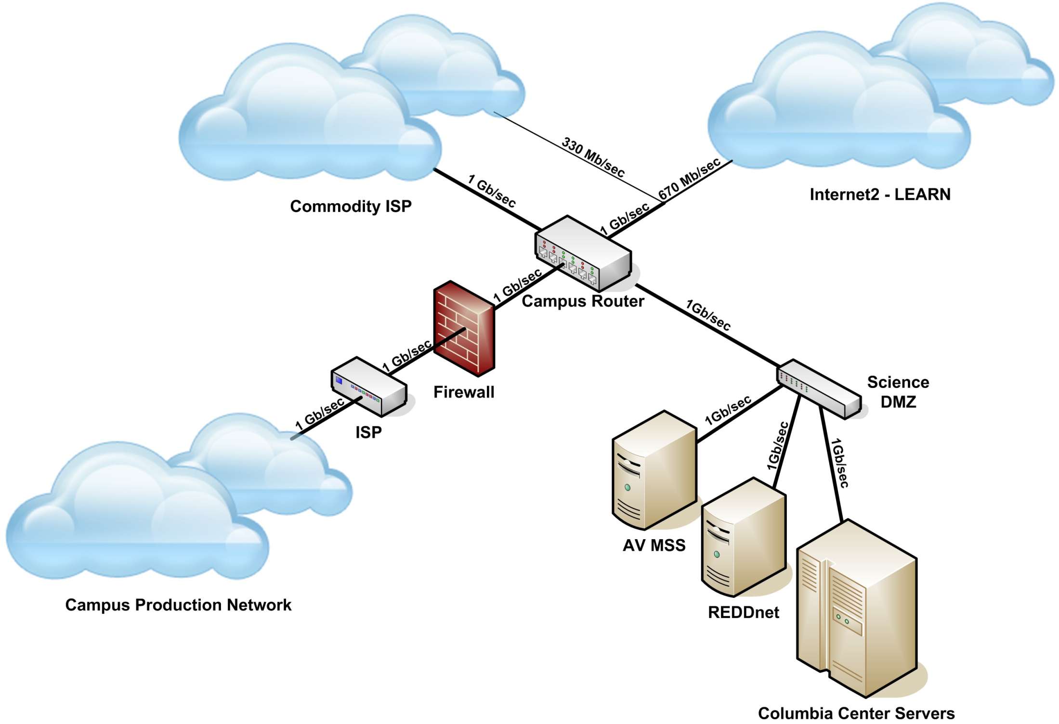

Slide 21
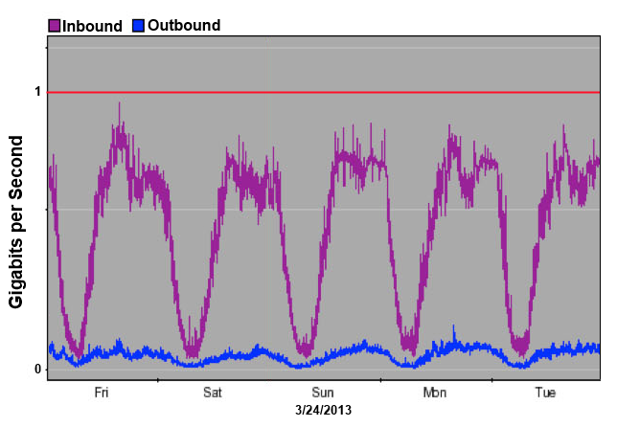

Slide 22
Current Issues and Trends in Higher Education
College Readiness/Common Core State Standards
College Access and Completion/Student Success
Assessment
Interdisciplinary Programs and Experiences
Non-state Funding Sources

Slide 23
Feedback on 2012 – 2013 Task Forces
Issue to Consider | Assigned Committee | Recommendations
College Readiness/Common Core State Standards | STEM Center Faculty Advisory Committee | Complete
College Access and Completion/Student Success | College Council | To be assigned
Assessment | College Assessment Committee | Complete
Interdisciplinary Programs and Experiences | Chairs | Complete
Non-state Funding Sources | Dean’s Advisory Board | In progress

Slide 24
College Readiness/Common Core State Standards –
STEM Center Faculty Advisory Committee
Dr. Matt Kwiatkowski – Biology
Dr. Michael Janusa – Chemistry/Biochemistry
Dr. Wes Brown – Geology
Dr. Jane Long – Mathematics/Statistics
Dr. Sara Bishop –Nursing
Dr. Walter Trikosko – Physics/Astronomy

Slide 25
Recommendations and Responses:
Recommendations
Responses
Video repository of lessons, teaching tips, etc.
Data on outreach programs
High school competitions and regional science fair
New bridge/study skills course similar to SFA 101 but following a STEM curriculum
More information on high school STEM Academy
Panel discussions
High School STEM Academy pilot with NISD – faculty opportunities for development this year
Data analysis complete on all STEM outreach events
Approval to design the SFA 101 classes specific to the needs of STEM majors
SMASH Camp – an excellent bridge camp for incoming freshmen
First panel discussion in planning stages

Slide 26
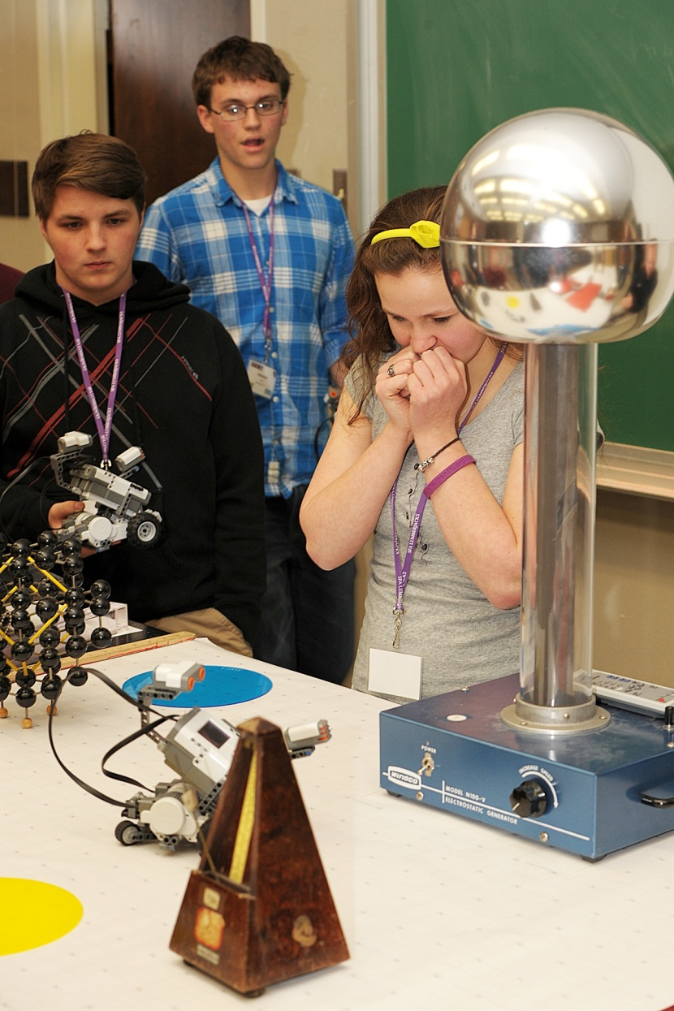
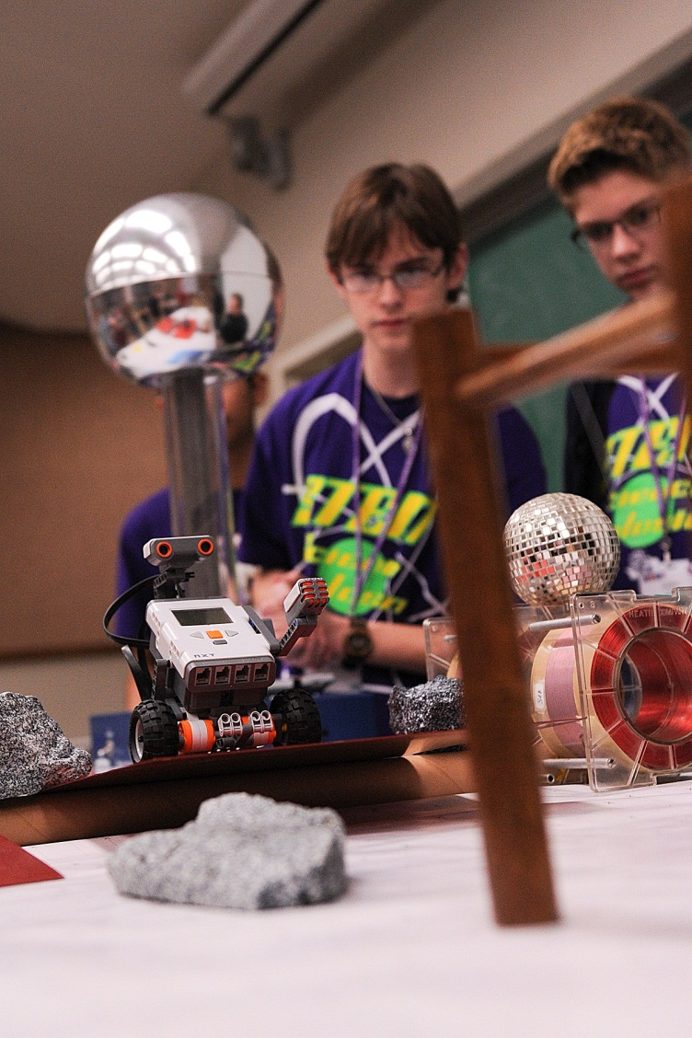
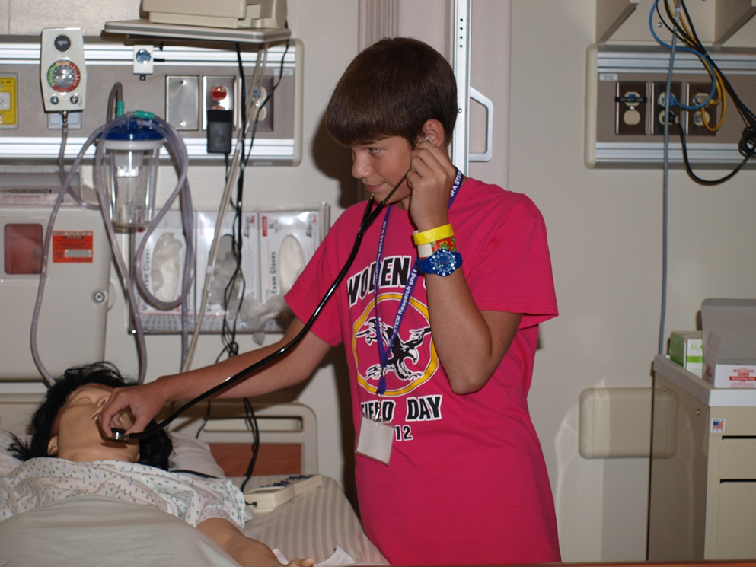
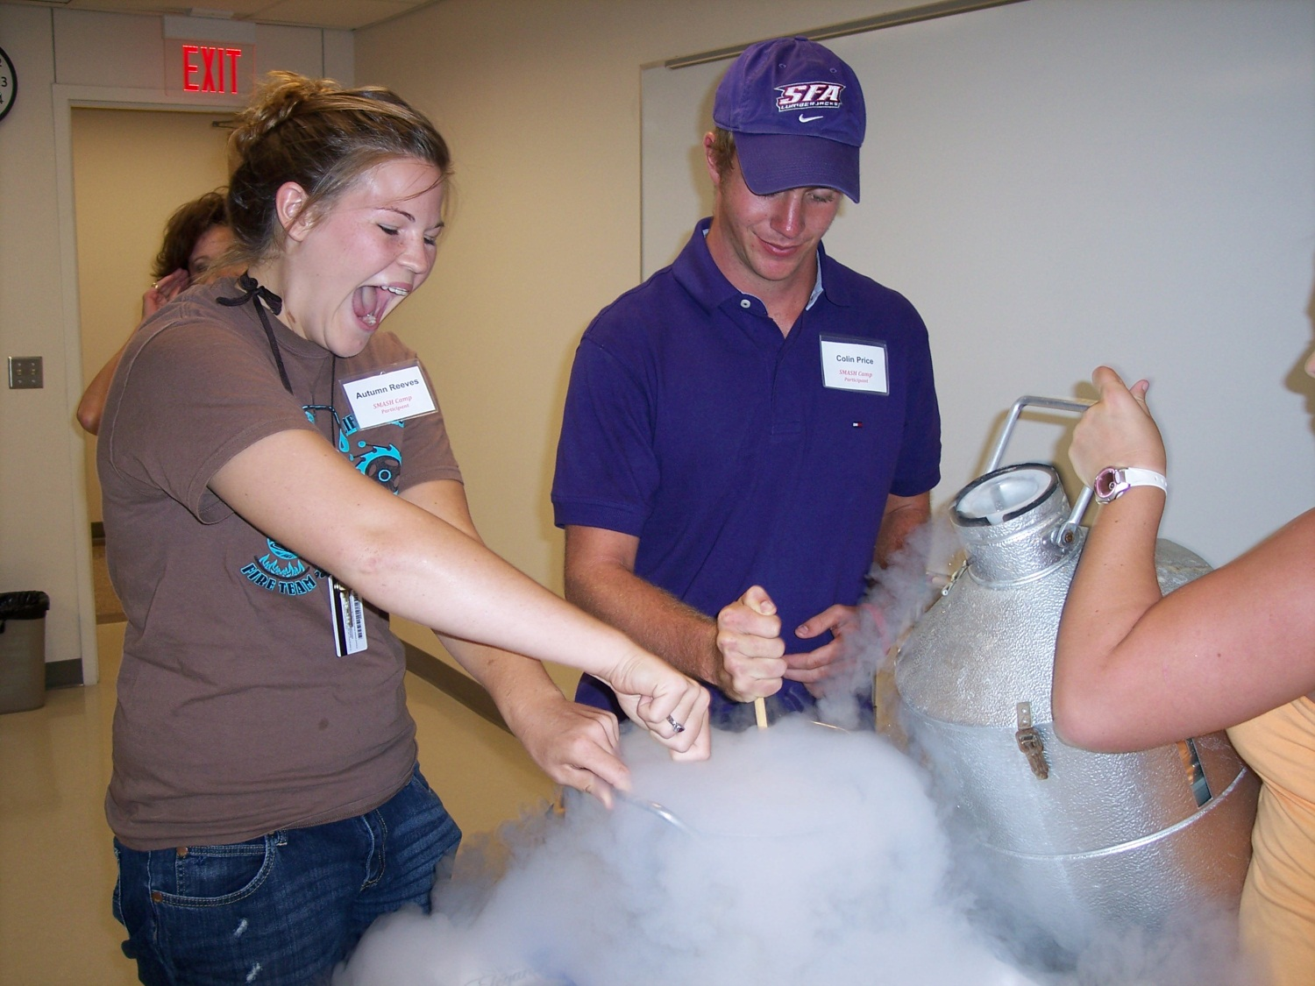
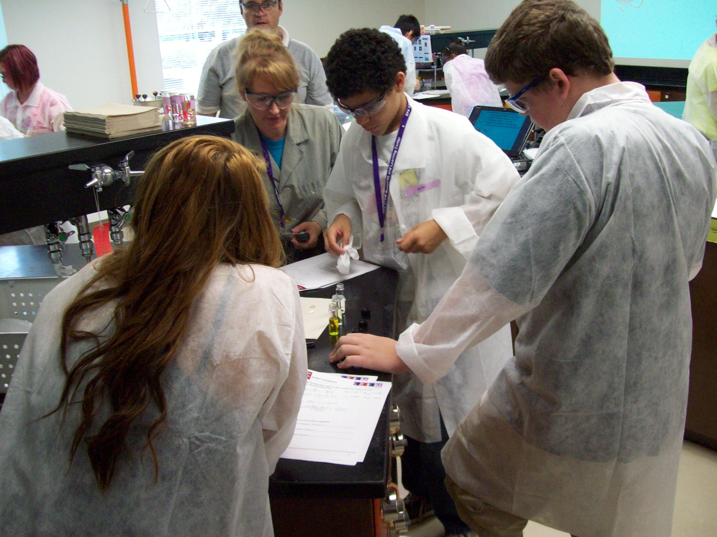
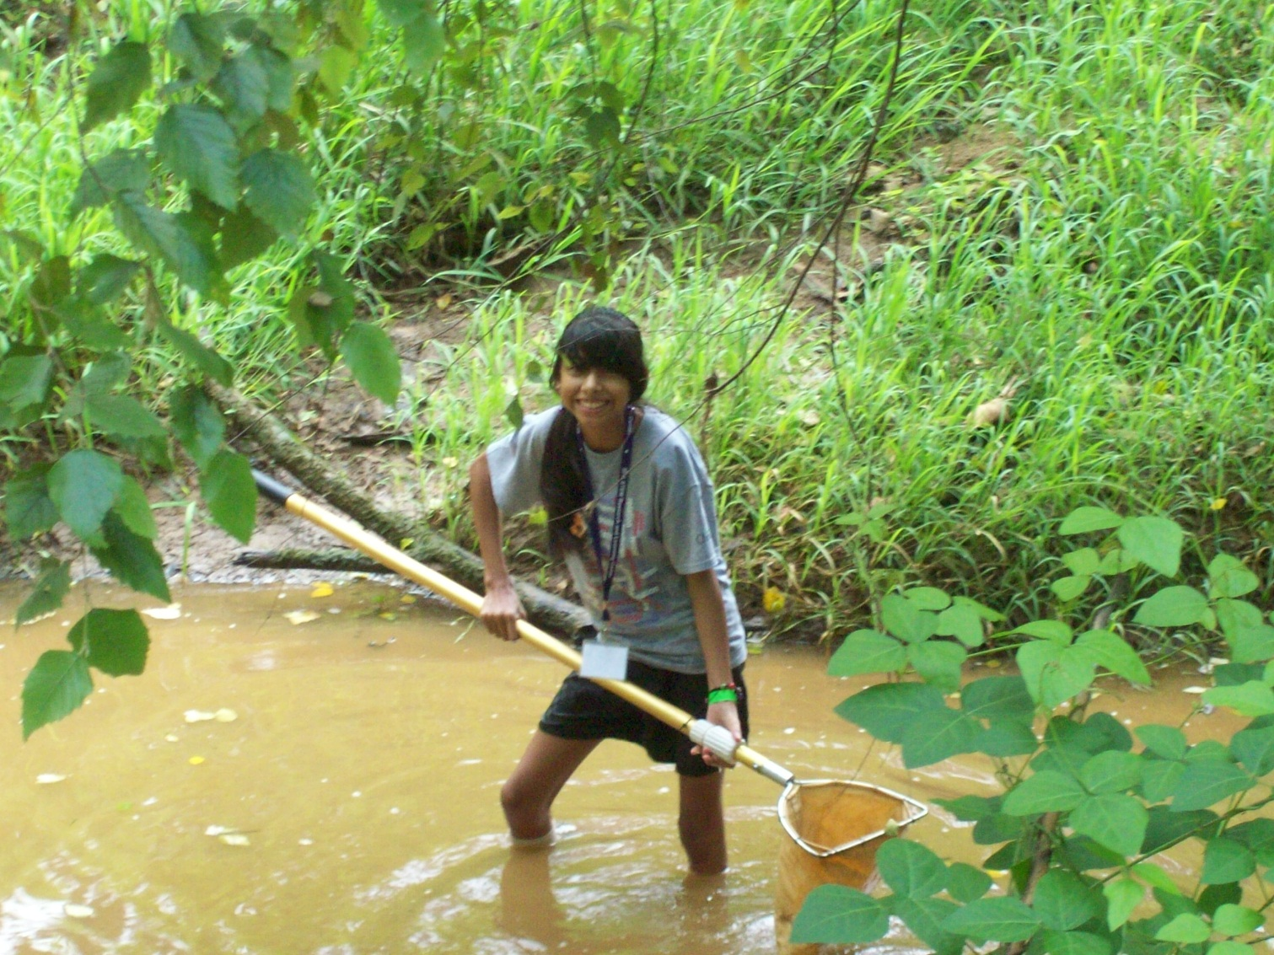
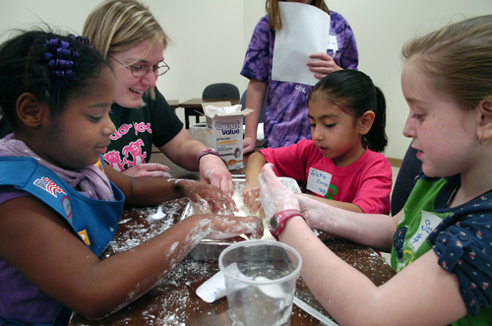
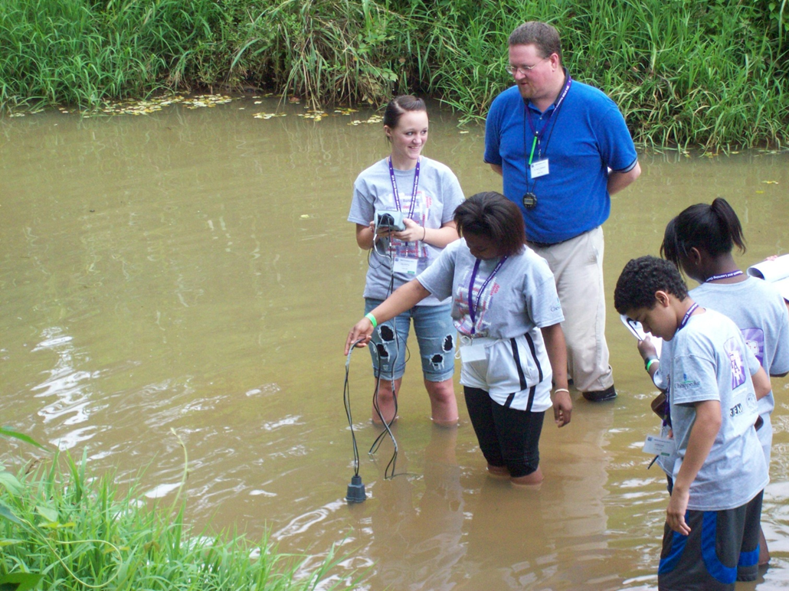
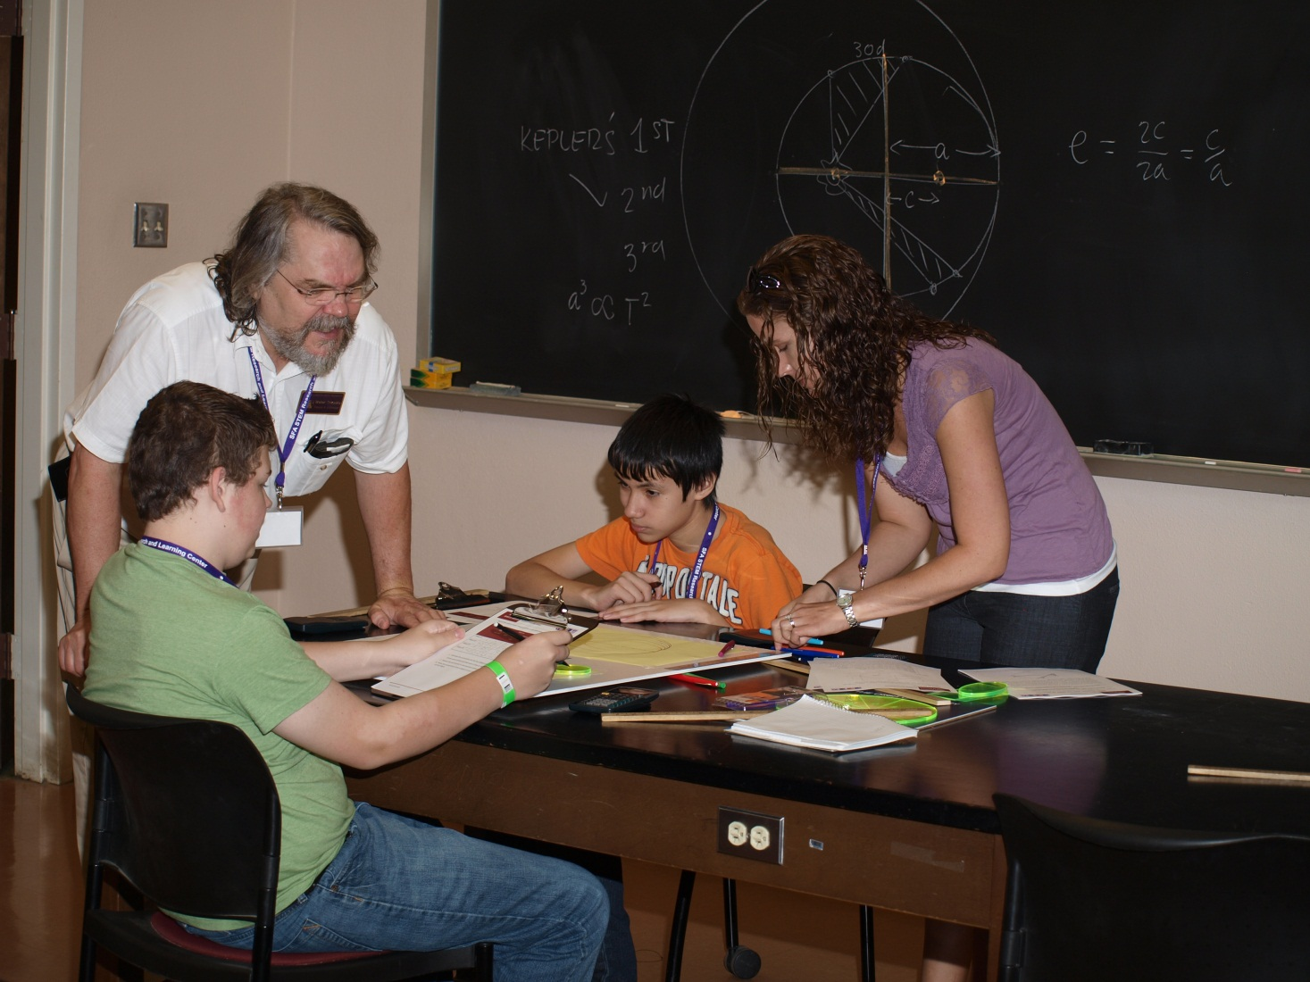
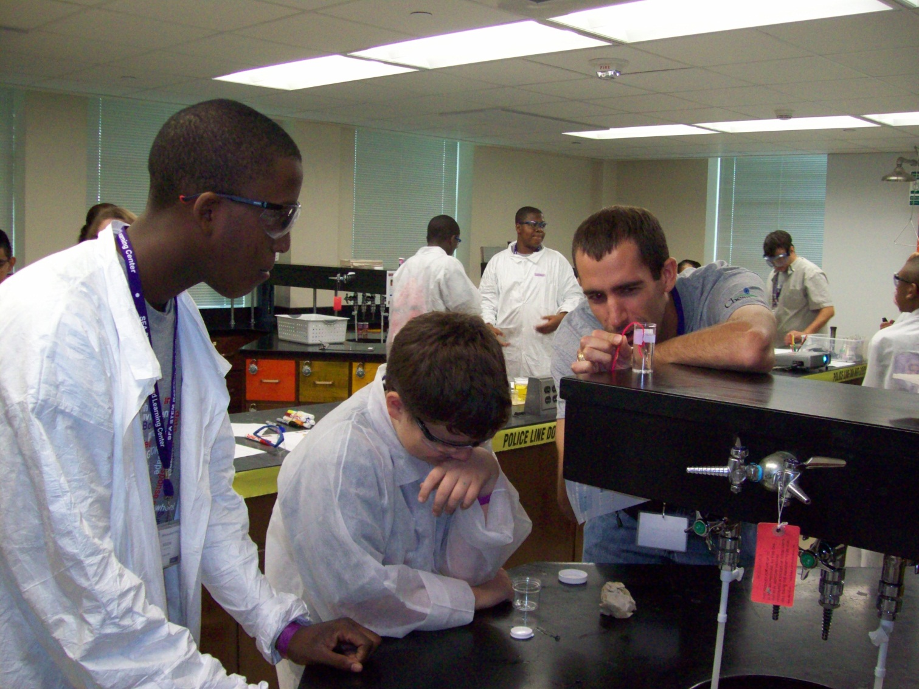
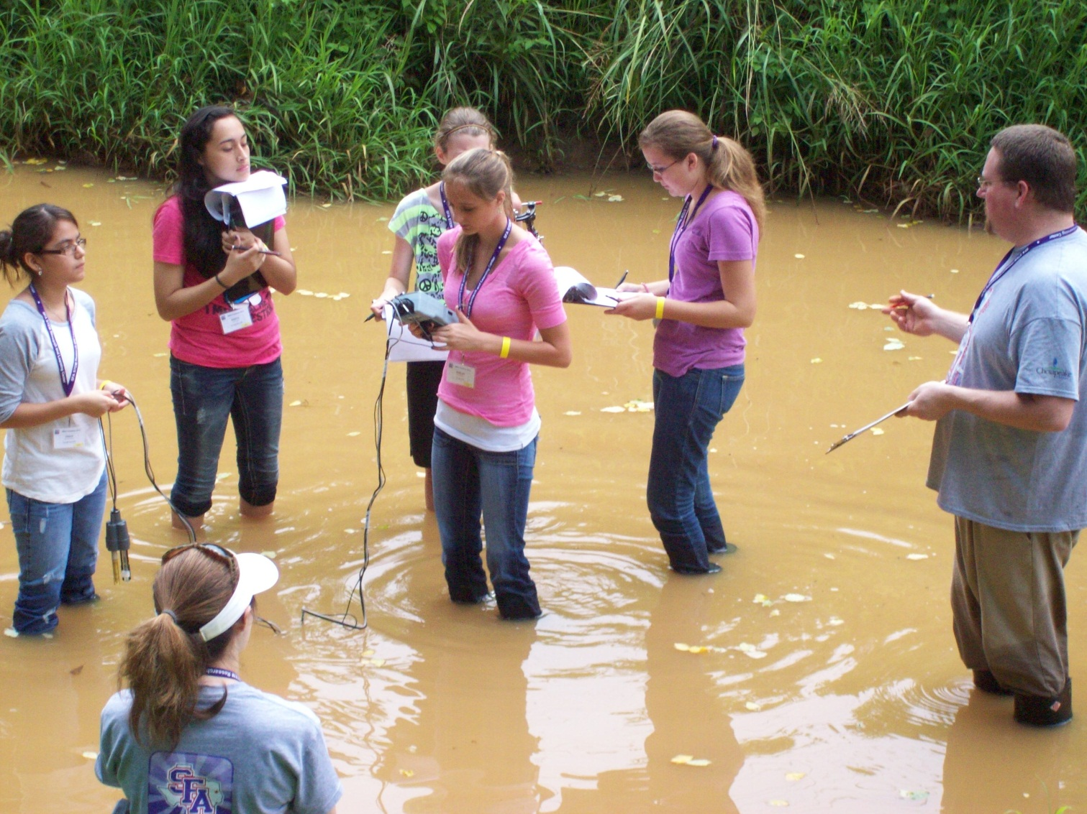
Engaging Students of All Ages in STEM!

Slide 27
Assessment –
College Assessment Committee
Dr. Rob Wiggers – Biology
Dr. Anthony Duben – Chemistry/Biochemistry
Ms. Mindy Shaw-Faulkner – Geology
Dr. Brian Beavers – Mathematics/Statistics
Dr. Rose Powell – Nursing
Dr. Norm Markworth – Physics/Astronomy
Dr. Debbie Pace – College of Sciences and Mathematics

Slide 28
Interdisciplinary Programs and Experiences - Chairs
Dr. Dennis Gravatt – Biology
Dr. Michael Janusa – Chemistry/Biochemistry
Dr. Kenneth Farrish – Geology
Dr. Debbie Pace – Mathematics/Statistics
Dr. Glenda Walker – Nursing
Dr. Harry Downing – Physics/Astronomy

Slide 29
Non-state Funding Sources …
Dean’s Advisory Board
Dr. Thomas Atchison – SFA Former Dean of CoSM
Mr. Gary Stokes – CEO, Nacogdoches Medical Center
Mr. Scott Thompson – Lockheed Martin
Ms. Kris Owens – Merrill Lynch
Mr. Roy Knight – Lufkin ISD Superintendent
Mr. Fred Hayes – Nacogdoches ISD Superintendent
Mr. Joe Max Green – CEO, Bancorp South Insurance
Dr. Aaron Polk – Private Practice Medicine
Mr. A. L. Mangum – SFA Foundation
Mr. Ernie LaFleur – CEO, EOG Resources

Slide 30
Making Connections …
Attendance at NAPE (North America Prospect Expo) Conference in Houston
Audience with the Coca-Cola Company in Atlanta
Presentation of the SFA STEM Initiative
  Area District Superintendents
  SFA Alumni (through Alumni Association)
  Civic organizations
Plans for 2013-14

Slide 31
Departments Working toward our College Goals…
Retention – Support retention activities of the College and the University.
Recruitment – Support recruitment activities of the College and the University.
Space and Equipment – Provide suitable space in area, equipment, and safety for instruction and research.
Teaching – Support quality teaching within the College.
Research – Support research/scholarly and other professional activity in the College.
Community & Public Service – Support community and public service activities throughout the College.

Slide 32
Biology
Space & Instrumentation
Research: Grants, Publications, Presentations
Research & Teaching
Teaching & Community Service
Licor 4300 DNA Analyzer
S. Canterberry
Organization of William W. Gibson Entomarium – D. Bennett
STEM initiative:
Zoology lab manual – B. Burt and M. Kwiatkowski
Research & Teaching
Acquisition of the Joe Pase Thailand Insect Collection – D. Bennett
A&P lab manual – G. Sullivan & E. Childress
J. Taylor - SMASH Camp iMAS Academies
D. Pratt – iMAS Academies
B. Clack
D. Gravatt
R. Havner
J. Taylor
S. Wagner
R. Wiggers
Renovation of histology lab to computer lab

Slide 33
Chemistry & Biochemistry
Upgraded Instrumentation
Research: Faculty/Student Publications
Teaching/Community Service
BAS Cyclic Voltmeter workstation
K. Onchoke
STEM initiative:
Student Research Involvement
Research Presentations
O. Odunuga
Eppendorf shaker, centrifuge and freezer
Paar density and sound velocity meter
Dionex ion chromatograph
Circulating water bath
Abacus computer workstation
Analytical balances
O. Odunuga
M. Harris
5 students
A. Frantzer – SMASH Camp
D. Fry – iMAS Academies
K. Onchose
A. Frantzen
10 students
Recruitment
Funded 2 community college transfer students to participate in summer research projects at SFA

Slide 34
Computer Science
Successfully completed program review
Submitted interim report to ABET, Inc. for continued accreditation of computer science degree program
Implemented a series of approved curriculum changes to update programs
Received approval to transition Computer Information Systems major to a B.S. degree
Participated in STEM outreach events

Slide 35
Geology
Research/Scholarly Activity
Dr. Wesley Brown
Teaching/ Community and Public Service
Geology Summer Field Camp
Collaboration with the US Geological Survey (USGS) and the UT Institute of Geophysics (UTIG) studying increases in seismic activity in East Texas.
Presentation of papers on the work at national level geophysics conferences. Final report in progress.
Six week rigorous summer learning experience for undergraduate geology majors conducted by SFA Geology faculty members in the Rocky Mountains.
The Field Camp has a national reputation of being an outstanding learning experience for geology majors, and is attracting geology students from across the nation.
This year, 14 of the 25 students participating in the camp were from other universities, including students from Michigan, Illinois, Louisiana, Kansas, Connecticut, Oklahoma, Pennsylvania, and Maine.
National Research/Teaching Best Practices Presentations:
E. Bailey W. Donnell
T. Harris S. Bishop
S. McDona D. Connor
Community/Public Service
  Pineywoods Fair/Health fairs at Shelbyville and Central Heights
  National Make-a-Difference Day
  Regional Disaster Simulation with the Texas Regional Disaster Team, regional hospitals, Fire & Rescue Units, SFA ROTC and Media class
  Hearing and Vision Screening at schools in Nacogdoches and Lufkin
  S. McDonald named to Healthy Nacogdoches Subcommittee for Childhood Obesity & Diabetes Prevention
Publications:
Carol Athey – Book Chapter in Perioperative Nursing Clinics
Recognitions:
Della Connor – Named to Speakers’ Bureau of the National Kidney Foundation Council of Advanced Practice

Slide 36
Mathematics and Statistics
State/ National Service
Student Involvement in Scholarly Activities/Research
Grants/Research and Scholarly Activity
State Tuning Committee – C. Richardson
State P – 16 Initiative – C. Richardson & S. Stovall
National Committee on Articulation & Placement – K. Hubbard
National Council of Teachers of Mathematics Conference – Denver, CO
Nebraska Conference for Undergraduate Women in Mathematics – University of Nebraska, Lincoln
NSF Noyce Conference – Washington, DC
Undergraduate Research Projects led by N. Long
1 Completed FRG – J. Long
2 New FRG – R. Henderson & N. Long
2 Completed FREGs – N. Long & K. Riggs
1 Minigrant – J. Becnel
Math Teachers Circle – J. Long
T4 Results – L. Beverly, K. Hubbard, D. Gravatt, K. Jenlink
$120,000 in scholarships last year; $200,000 this year
2 articles accepted for publication
Conference for the Advancement of Mathematics Teachers – San Antonio

Slide 37
DeWitt School of Nursing
Community/Public Service
Pineywoods Fair/Health fairs at Shelbyville and Central Heights
National Make-a-Difference Day
Regional Disaster Simulation with the Texas Regional Disaster Team, regional hospitals, Fire & Rescue Units, SFA ROTC and Media class
Hearing and Vision Screening at schools in Nacogdoches and Lufkin
S. McDonald named to Healthy Nacogdoches Subcommittee for Childhood Obesity & Diabetes Prevention
National Research/Teaching Best Practices Presentations:
Carol Athey – Book Chapter in Perioperative Nursing Clinics
E. Bailey
W. Donnell
T. Harris
S. Bishop
S. McDonald
D. Connor
Publications:
D. Connor – Named to Speakers’ Bureau of the National Kidney Foundation Council of Advanced Practice
National Research/Teaching Best Practices Presentations:
E. Bailey W. Donnell
T. Harris S. Bishop
S. McDona D. Connor
Community/Public Service
  Pineywoods Fair/Health fairs at Shelbyville and Central Heights
  National Make-a-Difference Day
  Regional Disaster Simulation with the Texas Regional Disaster Team, regional hospitals, Fire & Rescue Units, SFA ROTC and Media class
  Hearing and Vision Screening at schools in Nacogdoches and Lufkin
  S. McDonald named to Healthy Nacogdoches Subcommittee for Childhood Obesity & Diabetes Prevention
Publications:
Carol Athey – Book Chapter in Perioperative Nursing Clinics
Recognitions:
Della Connor – Named to Speakers’ Bureau of the National Kidney Foundation Council of Advanced Practice

Slide 38
Physics and Astronomy
Equipment Acquisitions
Perkin-Elmer VariSpec
Liquid crystal tunable optical filter
3 Ocean Optics SPS microspectrometers
Student Involvement - Retention
Society of Physics Students - Honorary Outstanding Chapter in nation.
Received Future Faces of Physics Award
Teaching and Community Public Service
Planetarium – 150 shows with 6000+ participants
6 faculty involved in iMAS, SMASH Camp, Girl/Cub Scout STEM Days
Recruitment and Retention
Graduated 3 M.S. and 1 M.S. in Natural Sciences
Graduated 9 B.S. – In the top 5 universities in Texas in graduation rate

Slide 39
National Figures – The Need to Widen the STEM Pipeline
Today, only 23% of college freshmen declare a STEM major … but just 40% of those receive a STEM degree within 6 years (about 6% of the total 3.6 million student population). We cannot make progress if these students are leaving STEM fields.
(Arne Duncan, 2009)
While only 4% of the nation’s workforce is composed of scientists and engineers, this group disproportionately creates jobs for the other 96%.
            (National Science Board, 2010)
Only 3 of the current top 10 college majors are categorized as science, technology, engineering or mathematics: Nursing – 3rd, Biology – 4th, and information technology – 10th.
(Princeton Review, 2010)

Slide 40
Looking Ahead …
The Year to Come…
Active distribution of Alumni, Foundation and University Endowment funds in scholarships for STEM majors
Strategic recruitment of transfer students
Active fund-raising efforts to support all college activity

Slide 41
Active recruitment – 2013-14
SFA College | First time Freshmen | Transfer students | Total “new” students
Business | 260 | 110 | 370
Education | 374 | 232 | 606
Fine Arts | 179 | 51 | 230
Forestry & Agriculture | 118 | 58 | 176
Liberal & Applied Arts | 417 | 152 | 569
Sciences & Mathematics | 679 | 135 | 814

Slide 42
Degrees Awarded
College of Sciences and Mathematics

Slide 43
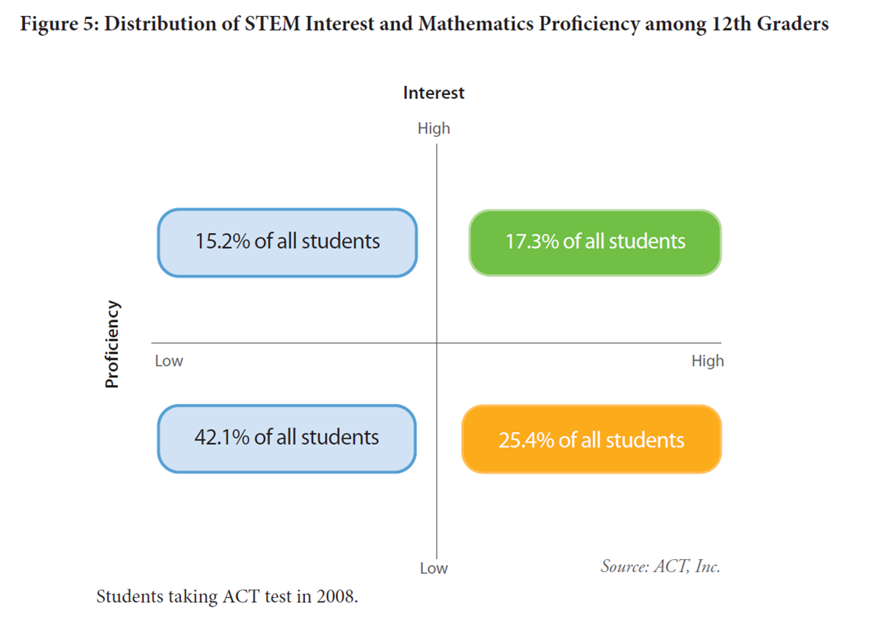

Slide 44
Programs Offered
Bachelor’s Degrees:
  Biology
  Biochemistry
  Chemistry
  Computer Information Systems*
  Computer Science*
  Geology
  Information Technology*
  Mathematics
  Nursing
  Physics
Minors:
  Applied Statistics
  Astronomy
  Biology
  Chemistry
  Computer Information Systems*
  Computer Science*
  Engineering
  Geology
  Information Technology*
  Mathematics
  Physics
* New as of Fall 2013

Slide 45
Programs Offered
Pre-Health Professions:
  Pre-Dentistry
  Pre-Medicine
  Pre-Optometry
  Pre-Occupational Therapy
  Pre-Pharmacy
  Pre-Physical Therapy
  Pre-Physician Assistant
  Pre-Veterinary Medicine
Pre-Engineering
Master’s Degrees:
  Biology
  Biotechnology
  Geology
  Mathematics
  Natural Sciences*
  School Mathematics Teaching
  Statistics
* The MS in Natural Sciences is an interdisciplinary degree program with a variety of tracks available, including Chemistry and Physics.

Slide 46
Freshman Convocation – Dr. Keith Hubbard
September 5, 4 – 6 p.m.
Goals for students:
  Know departments, department chairs, admin assistants
  Connect with academic clubs
  Spend time interacting with majors and faculty
  Acquire pride at being a part of the best college on campus
Schedule:
  4:05-4:25 opening session @ Kennedy
  4:30-5:15 activities and giveaways @ departments
  5:15-6:00 pizza and t-shirts with student clubs @ Kennedy

Slide 47
Dealing with Troubled and Troubling Students and Title IX Requirements
Dr. Adam Peck

Slide 48
Looking Ahead
“Our deepest fear is not that we are inadequate. Our deepest fear is that we are powerful beyond measure. It is our light, not our darkness, that most frightens us … As we are liberated from our own fear, our presence automatically liberates others.”
Nelson Mandela

Slide 49
Bonus Slides

Slide 50
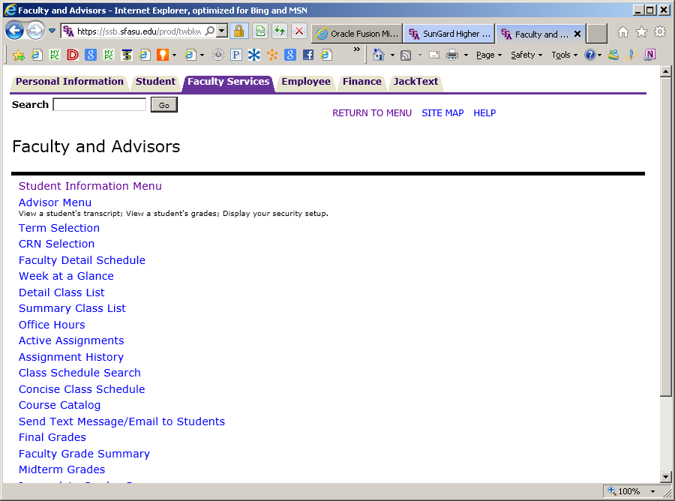
F.E.R.P.A.
Family Educational Rights and Privacy Act

Slide 51
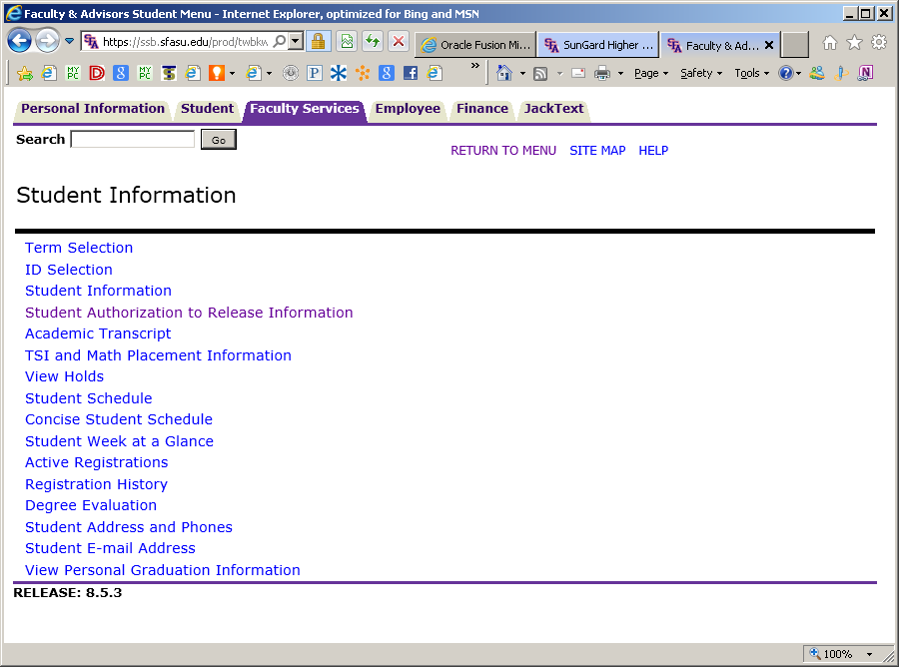
F.E.R.P.A.
Family Educational Rights and Privacy Act

Slide 52
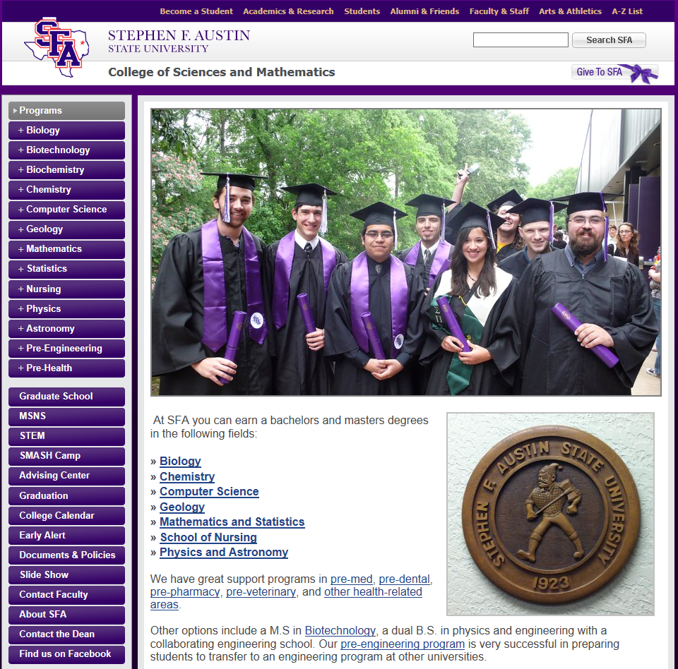

Slide 53
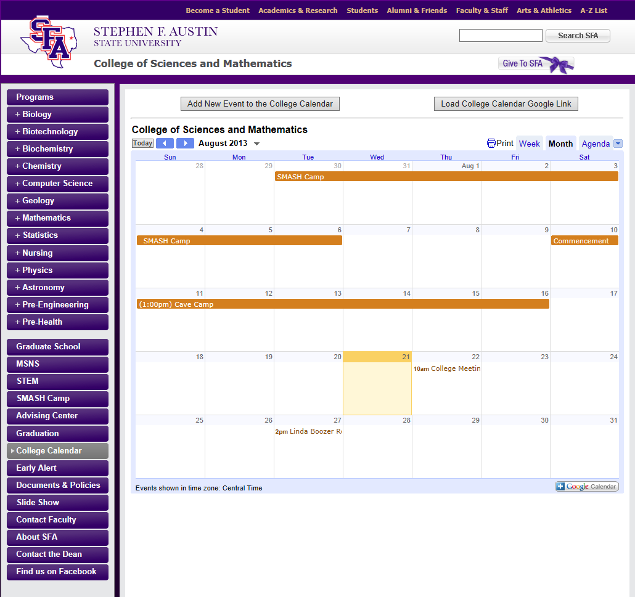

Slide 54
